Slide 1

Developing Your Rubric

Slide 2
Step 1
Identify what type of
rubric you want to create –
holistic or analytic.

Slide 3

Step 2—Identify the outcomes for your rubric:
  These should be things that you want your students to learn through the process of completing this assignment.

Slide 4
Step 2—Identify the outcomes for your rubric:
  Your rubric can include both course specific outcomes and Campus-wide Outcomes. Some outcomes may even cross over and be one in the same. This is okay.

Slide 5
Step 3
Determine how many levels you will have on your rubric. For example, will you have a level for each grade range (A-range, B-range, C-range, etc.) or will you have only several levels such as “outstanding,” “acceptable,” “not acceptable”?

Slide 6

Step 4
Determine a descriptive label for each of these categories.
For example, “A-Range” is a category.

Slide 7
Step 4
However, you don’t have to use grades.

Slide 8
Step 4
A descriptive word like “Emerging” or “Developing” can sometimes work better as labels for categories because they focus students on the description rather than the grade.

Slide 9
Step 5
Describe the best work you could expect using the characteristics you selected. This describes the top category.

Slide 10

Step 5
Note: the best way to do this is to start with student work that you have sorted into several piles (excellent, okay, poor).

Slide 11

Step 5
Then read through the “excellent” pile of work and describe what makes it excellent. This will help you form this top category.

Slide 12

Step 6
Describe the worst acceptable product using the characteristics you selected. This describes the lowest acceptable category.

Slide 13

Step 6
Again, you can do this by starting with the student work and working backwards into the language to describe the work in this category.

Slide 14

Step 7
Develop descriptions of intermediate-level products and assign them to intermediate categories.

Slide 15
Step 7
You might develop a scale that runs from 1 to 5 (unacceptable, marginal, acceptable, good, outstanding), 1 to 3 (novice, competent, exemplary), or any other set that is meaningful. Use student work to help you determine these levels.

Slide 16

Step 8
Continue to monitor the language and vocabulary you use in your rubric. Make sure it is written in a way your audience will understand.

Slide 17
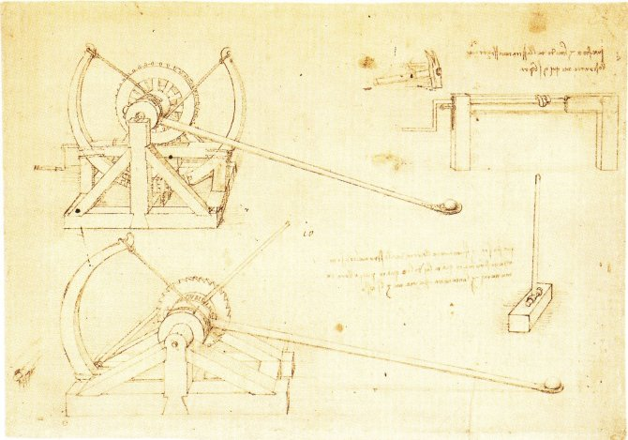
Step 9
Remember to use sample rubrics for language that you can adopt for your own rubric. You need not “invent the wheel.”

Slide 18

Step 10
Plan to revise your rubric after testing it on student work.

Slide 19

Step 10
Often you will begin with a rubric that seems perfect, but during the process of using that rubric to score student work, you will find areas that you forgot to include on the rubric or that are in adequate and need to be revised.

Slide 20
Step 11
Peer feedback can also help you further revise your rubric.

