Slide 1
Hybrid Course Overview & Requirements
Math 62, 70, 72, 97

Slide 2
Hybrid Class Details

Slide 3
Class Format
Your primary “instructor” is the Hawkes computer courseware
This is NOT a distance education class but is considered a FLEX or HYBRID course – meaning you must take tests here in the classroom
All assignments and tests are completed on a computer
There are no lectures, but I am here to assist you when you need help

Slide 4
Advantages of Hybrid
While there are deadlines for assignments and tests, students find this format a bit more flexibile
All work except tests can be done at home or on other computers
It is a good way to review material that you have learned in the past

Slide 5
Disadvantages of Hybrid
Some students are more successful in a more structured, lecture environment
While there is an instructor available to help, you are mostly responsible for learning the material via the computer courseware.
There are no scheduled lectures

Slide 6
Criteria for Success
You like math, or can maintain a positive attitude while learning math
You like learning math on your own
The material you are learning is, for the most part, a review of material you have had in the past but may have forgotten some of it
You are VERY self motivated

Slide 7
Attendance Requirement
Attendance is required for orientation
Attendance is required for TESTS. Test are taken in class during your scheduled class time
Your instructor is in attendance during every class. You may attend as necessary to get the help that you need.

Slide 8
Course Materials

Slide 9
Materials Needed
Pencil or pen
Notebook for taking notes and working problems
Calculator:
Math 62 & 70 – scientific calculator (like a TI-30)
Math 72 & 97 – graphing calculator (TI-83 or 84 is recommended. Our Math Learning Center (MLC) in CH 313 rents calculators out for the quarter
Access Code for Developmental Math software from Hawkes Learning Systems

Slide 10
Purchase Options for Software
Options listed are from least expensive to most:
Access code for the software purchased directly from Hawkes Learning website (www.hawkeslearning.com)*
Access code for the software and CD purchased at the GRC bookstore
Book and Access code and CD for the software purchased at the GRC bookstore
* An e-book can be purchased from Hawkes directly

Slide 11
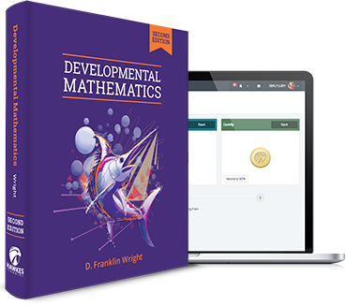
Developmental Math – Second Edition Hawkes Learning

Slide 12
Hawkes Learning Website
Hawkes Learning website
Go to the Students section to purchase your access code

Slide 13
Hawkes Course Website
LEARN (https://learn.hawkeslearning.com)
This is the website you will use to access the Hawkes program each day

Slide 14
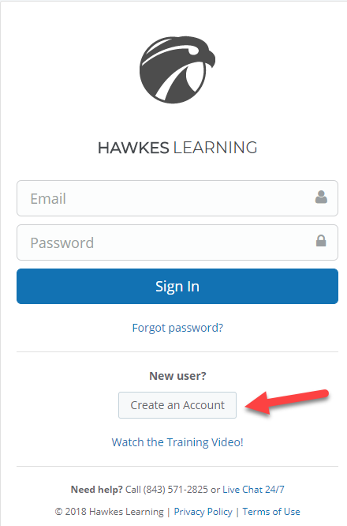
First Time Logging On
Click on Create an Account

Slide 15
If you have used Hawkes before
Your access code is still good
Log on like you did in your prior course
Click on the arrow next to your name
Go to SETTINGS
Click on COURSES tab
Click on TRANSFER

Slide 16
Your Grade Details

Slide 17
Your Grade Includes
Certify lesson quizzes
Pre-Tests
Tests
Final Exam

Slide 18
Certifies
Certifies are the quizzes after each unit lesson
You are allowed to miss a certain number of questions and still pass. You must get about 80% of the problems correct
If you miss more than the allowed number of questions, you may re-do the quiz with no penalty
When you pass the Certify, your grade is 100% (unless it is after the deadline, your instructor may assign a late penalty)
You must complete all required Certify quizzes before you will be able to take the unit test

Slide 19
Pre-Test Assignments
Pre-Tests are a part of your grade!
You must complete the Pre-Test prior to taking the Test
Pre-Tests may be taken multiple times. The highest grade is automatically recorded
Pre-Tests may be taken at home

Slide 20
Tests
Tests must be taken IN CLASS and during your class time
ALL Certify quizzes must be completed prior to the Test (or you will be blocked from taking it)
You may take any test EARLY!
Check in with your instructor to take a test

Slide 21
Final Exam
The Final Exam must be taken IN CLASS and during your scheduled final exam time
You may take the final exam early

