Slide 1

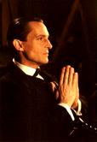
“What is the meaning of it, Watson? … It must tend to some end, or else our universe is ruled by chance, which is unthinkable. But what end?”
“There is the great standing perennial problem to which human reason is as far from an answer as ever.”
Sherlock Holmes, 1892

Slide 2
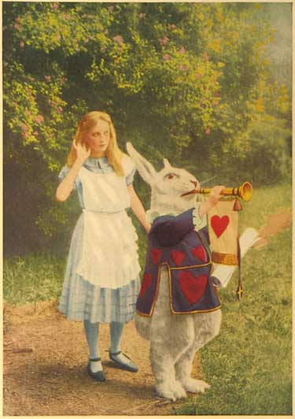
Peek-A-Boo, Quantum Slits and Rabbit Holes
What modern physics
does (and does not)
say about reality.

Slide 3
Everything you always wanted to know about…
The nature of science, quantum mechanics, God, peek-a-boo, free will, cupcakes, ice cream, half-dead cats, and Hamlet…
…will not be answered
during this talk.
I will try to mention all of those things.

Slide 4
Apologies for formality:
According to Dr. Gerry Wheeler, former Executive Director of the National Science Teachers Association…
“Power corrupts,
and PowerPoint corrupts absolutely.”

Slide 5


Also according to Dr. Wheeler:
There is a new “complementarity principle”
of science teaching:

Slide 6
Can you handle the truth?
When asked (by People Magazine) to explain Quantum Electrodynamics,
Richard Feynman replied:
“If I could explain it to the average person
it wouldn’t be worth the Nobel Prize.”

Slide 7
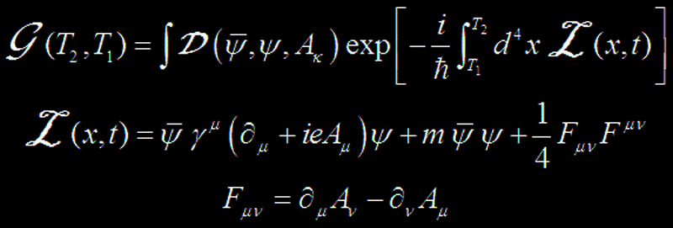
The Truth!
Quantum Electrodynamics:

Slide 8
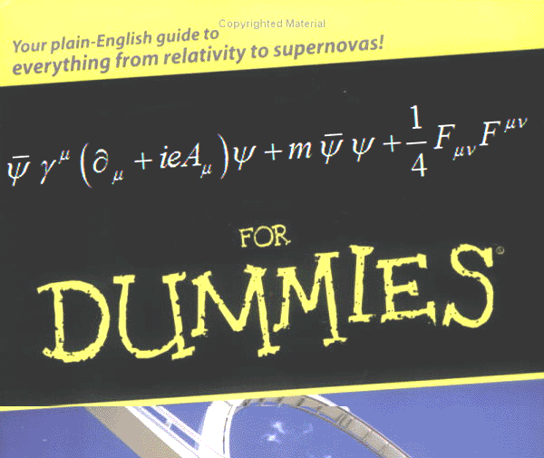
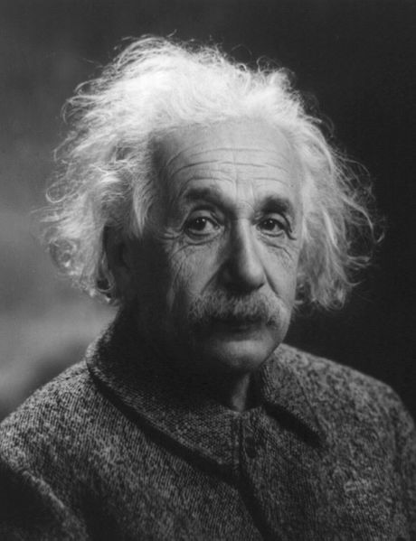
Why do scientists fear “Clarity”?
Everything should be made as simple as possible,
but not simpler.

Slide 9
Where can we find clarity?
Scientific knowledge is finite.
Scientific inquiry leads
to more questions.
Certainty is more comfortable.
Religion can provide that.

Slide 10
Science and Religion
Three popular works on science and religion follow.
Ideas expressed in each of them may be right or wrong.
Some ideas are outside the realm of science.
The distinction between science and religion may be valuable.

Slide 11
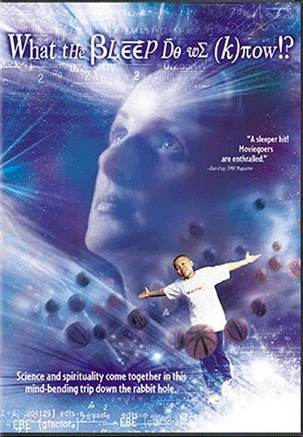
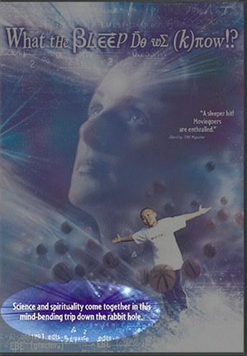
Science and Religion I
Science = Pantheism
“Science says”
We create the universe just by thinking about it
A belief held by Freeman Dyson, etc.
2004

Slide 12
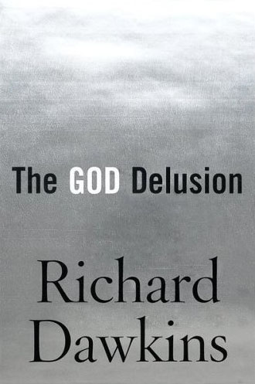
Science and Religion II
Rationality = Atheism
“Science says”
The universe is ruled by chance, not God
A belief held by Richard Feynman, etc.
2007

Slide 13
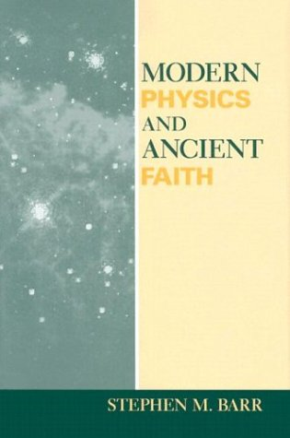
Science and Religion III
Physics = Theism
(with a capital “T”)
“Science says”
There is an active conscious God
A belief held by
Stephen Barr,
Quantum Field Theorist
2003

Slide 14
Is anything wrong with this?
Any of these religious ideas
could be correct.
Confusing science and religion potentially weakens both:
  Science relies on skepticism.
  Religion depends on faith.

Slide 15
Map of this talk
Pictures and conversations:
The nature of science
Inside the Rabbit Hole:
Quantum physics
Through the Looking Glass:
Quantum physics and reality
Seeking a way out of the wood:
Science and religion

Slide 16
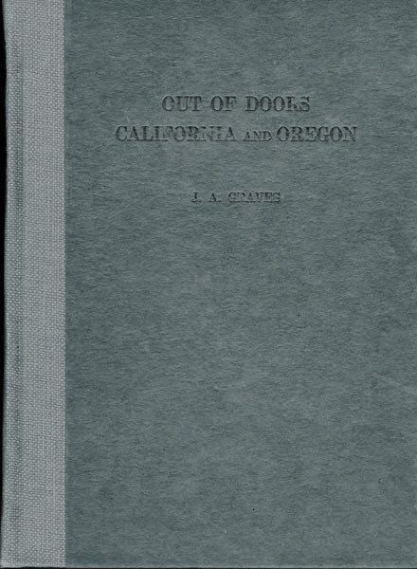
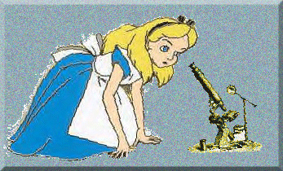
Pictures and conversations:
The nature
of science
"What is the use of a book," thought Alice, "without pictures or conversations?”
SCIENCE

Slide 17
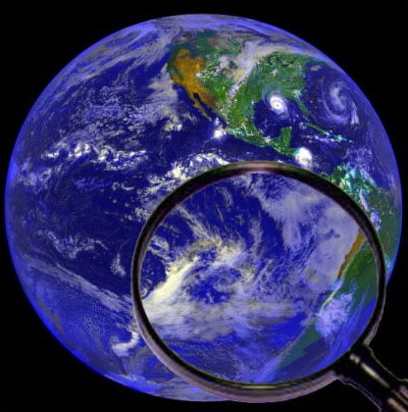
The nature of science
Prediction
Experiment
Mental Model
Idea
Observation

Slide 18
The nature of science
Scientists make mental models:
“Pictures” of the real world.
Then they test the models:
“Conversations” with nature.

Slide 19
What isn’t science?
If it isn’t accessible to
  Observation
  Prediction
  Experiment
It isn’t science.
(That doesn’t mean it’s wrong.)

Slide 20
Is this science?
I drop a ball.
I notice that it falls.
I hypothesize that it fell because I’m standing on a large massive object (the Earth) which pulled on the ball.
HINT: Could we devise an experiment
to test the hypothesis?

Slide 21
Is this science?
I drop a ball.
I notice that it falls.
I hypothesize that it fell because a divine being wanted it to fall.
No experiment could test this hypothesis
so it isn’t science. Science can’t say
anything about this hypothesis.

Slide 22
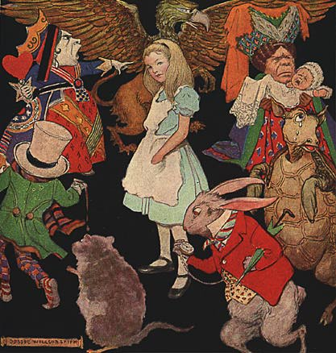
Quantum Physics:
Inside the
Rabbit Hole
Artwork by Jessie Wilcox-Smith

Slide 23
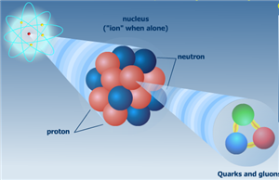
Inside the nucleus
These guys are fast!

Slide 24
Quantum Physics: A History
Max Planck (1901)
Albert Einstein (1905)
Niels Bohr (1913)
Louis de Broglie (1924)
Schrodinger, Heisenberg, Dirac (1926)
Feynman, Schwinger, Tomonaga (1940)
… and so on…

Slide 25
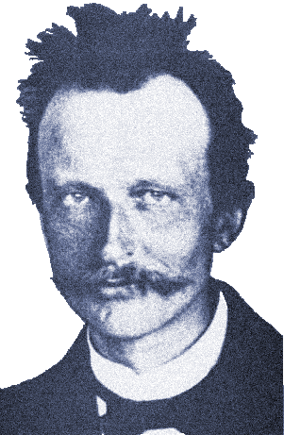
Quantum Theory Begins
Light has some of the properties of particles.
And I should care because…why?
Max Planck (1901)

Slide 26

Waves and Particles
One particle…
… plus another particle …
… equals two particles.

Slide 27
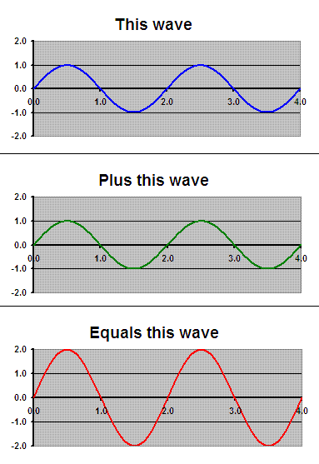
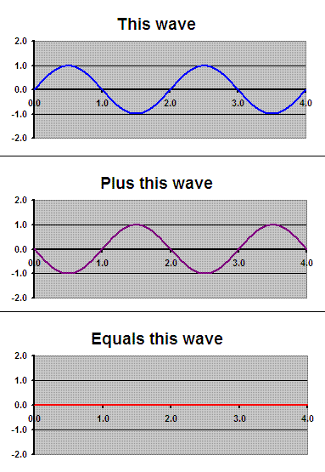
Waves and Particles
One wave plus another wave equals ???

Slide 28
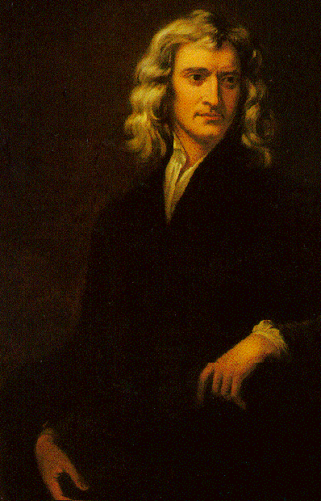
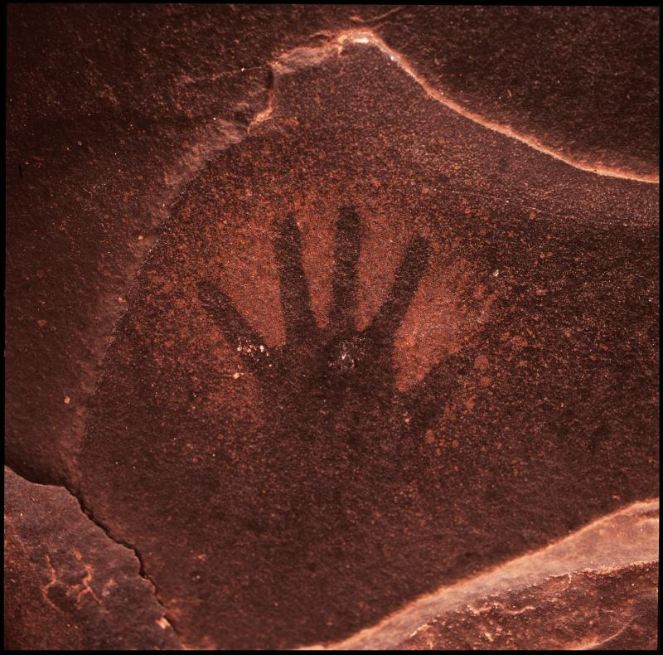
Waves or particles?
Light is composed
of particles.
Isaac Newton (1675)

Slide 29
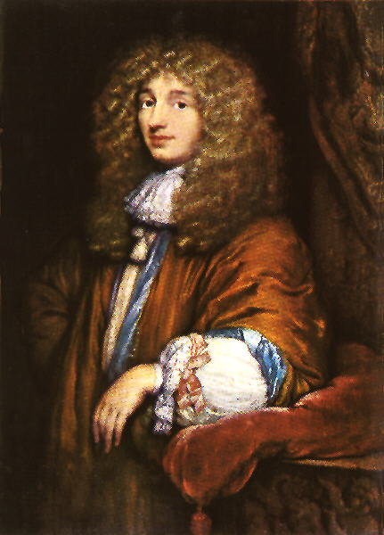
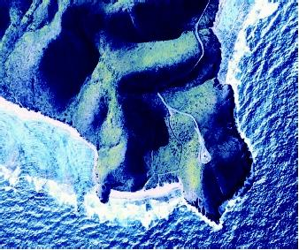
Waves or particles?
Light is composed
of waves.
Christian Huygens (1678)

Slide 30
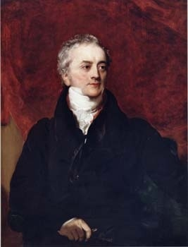
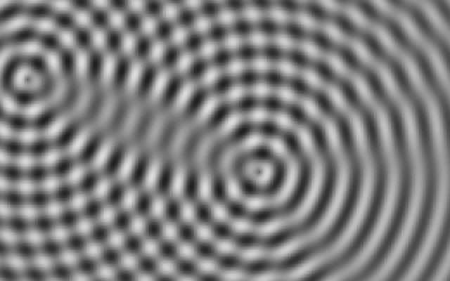
Waves or particles?
Huygens was right.
Light is a wave.
Thomas Young (1799)

Slide 31
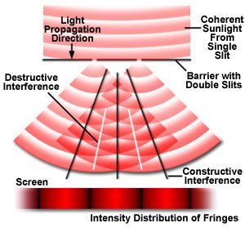
Young’s Double Slit Experiment

Slide 32
Young’s Double Slit Experiment
Computer simulations by U of Colorado
PhET: http://phet.colorado.edu
Demonstration with sound:
http://phet.colorado.edu/new/simulations/sims.php?sim=Sound
Demonstration with light, etc.:
http://phet.colorado.edu/new/simulations/sims.php?sim=Quantum_Wave_Interference

Slide 33
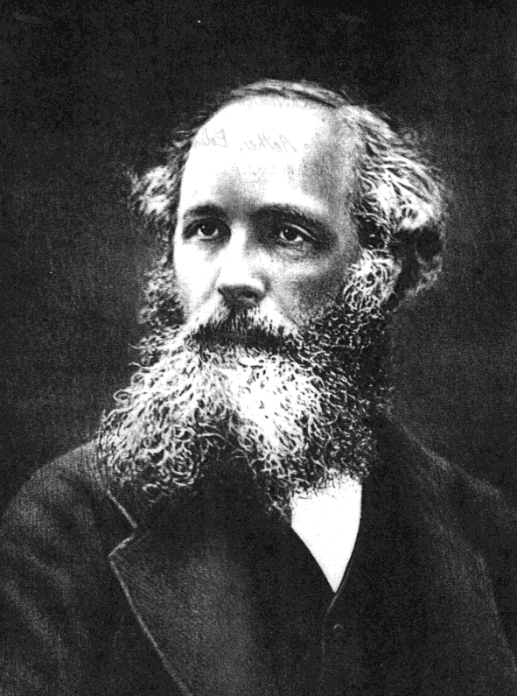
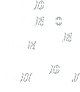
Waves or particles?
(So light is a wave.)
J. C. Maxwell (1861)

Slide 34
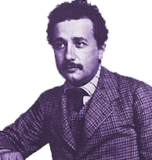
Quantum Theory Begins
Light has some of the properties of particles.
But if Young was right,
that means light has properties of particles AND properties of waves.
Yep.
Max Planck (1901)
Albert Einstein (1905)

Slide 35
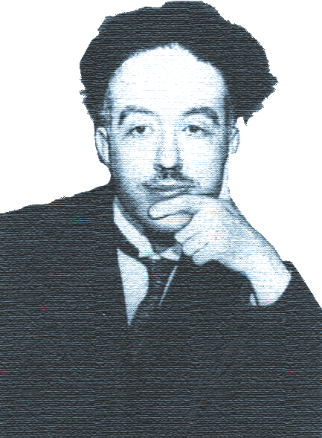
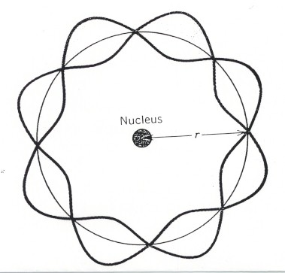
Waves or particles?
Atoms and electrons have some properties of waves.
Louis de Broglie (1924)

Slide 36
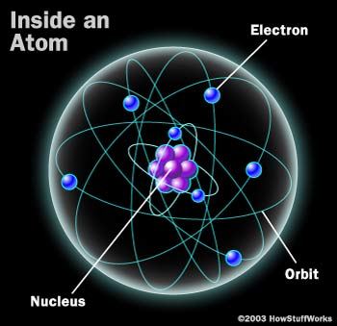
Map of the atom

Slide 37
Waves or particles?
Atoms and electrons have some properties of waves.
Louis de Broglie (1924)

Slide 38
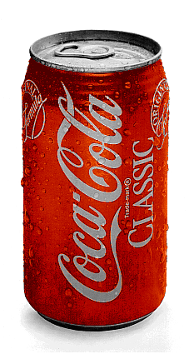
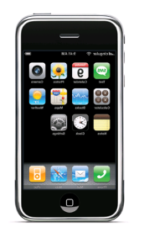

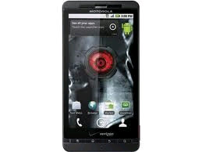
Waves or particles?
Waves
(such as light)
are PARTICLES.
PARTICLES!
Less Filling!
Particles
(such as atoms)
are WAVES.
WAVES!
Tastes Great!

Slide 39



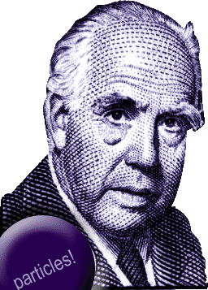
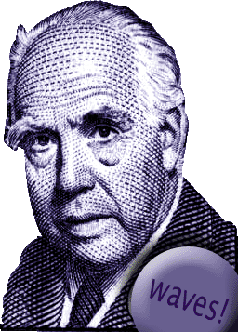
Waves or particles?
STOP!
They’re particles…
Yin…
.
STOP!
and they’re waves.
and yang.
Niels Bohr (1925)

Slide 40
Just for fun…
The logo of the Niels Bohr Institute, High Energy Heavy Ion (HEHI) group in Copenhagen :

Slide 41

Just for fun…
The logo of the Niels Bohr Institute, High Energy Heavy Ion (HEHI) group in Copenhagen :

Slide 42
Wave + Particle = “Quantum”
But what does a “wave-particle”
or “quantum” do?
Back to the University of Colorado:
http://phet.colorado.edu/new/simulations/sims.php?sim=Quantum_Wave_Interference

Slide 43
Wave + Particle = “Quantum”
If you don’t know which slit a particle went through…
…it will act like a wave that went through both…
… and interfere with itself.

Slide 44
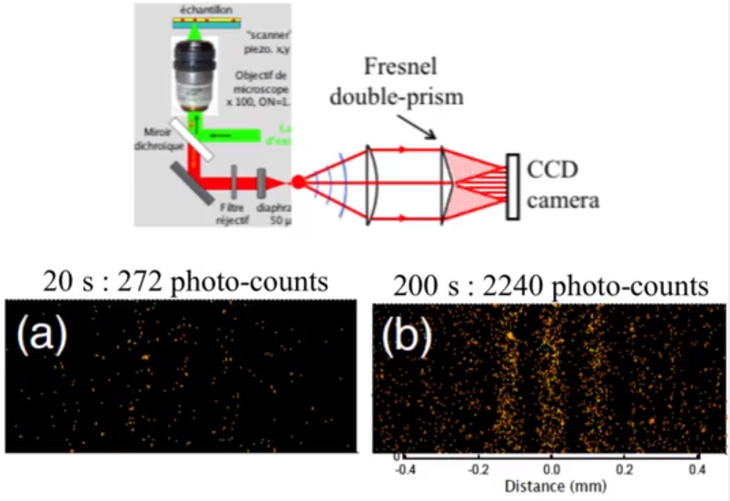
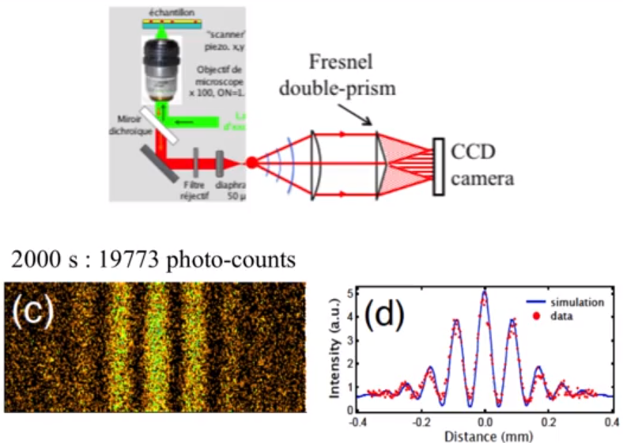
Wave + Particle = “Quantum”

Slide 45
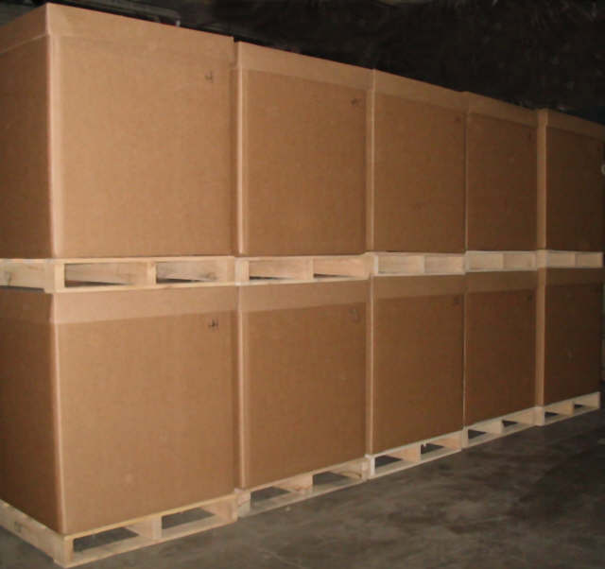
Wave + Particle = “Quantum”
Alternate experiment:
Build a bunch of “boxes”
Trap the particle in one of them
…without knowing which one.
Release the particle
It should interfere with
itself like a bunch
of waves that came
from each box.

Slide 46
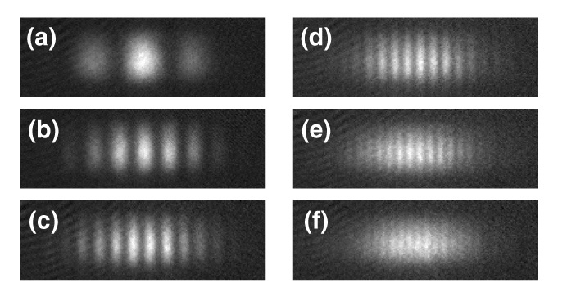
Wave + Particle = “Quantum”
Actual photos of atoms released
from Ramsey traps.

Slide 47
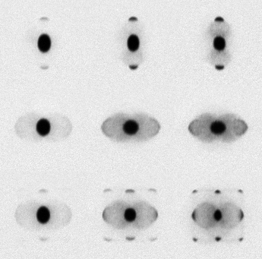
Wave + Particle = “Quantum”
Photos of atoms interfering after release from a two dimensional grid of slits.

Slide 48
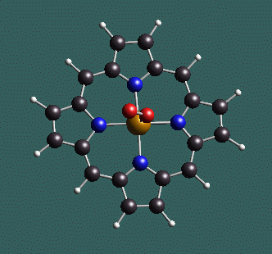
Wave + Particle = “Quantum”
A porphyrin ring:
a large quantum “particle”.

Slide 49
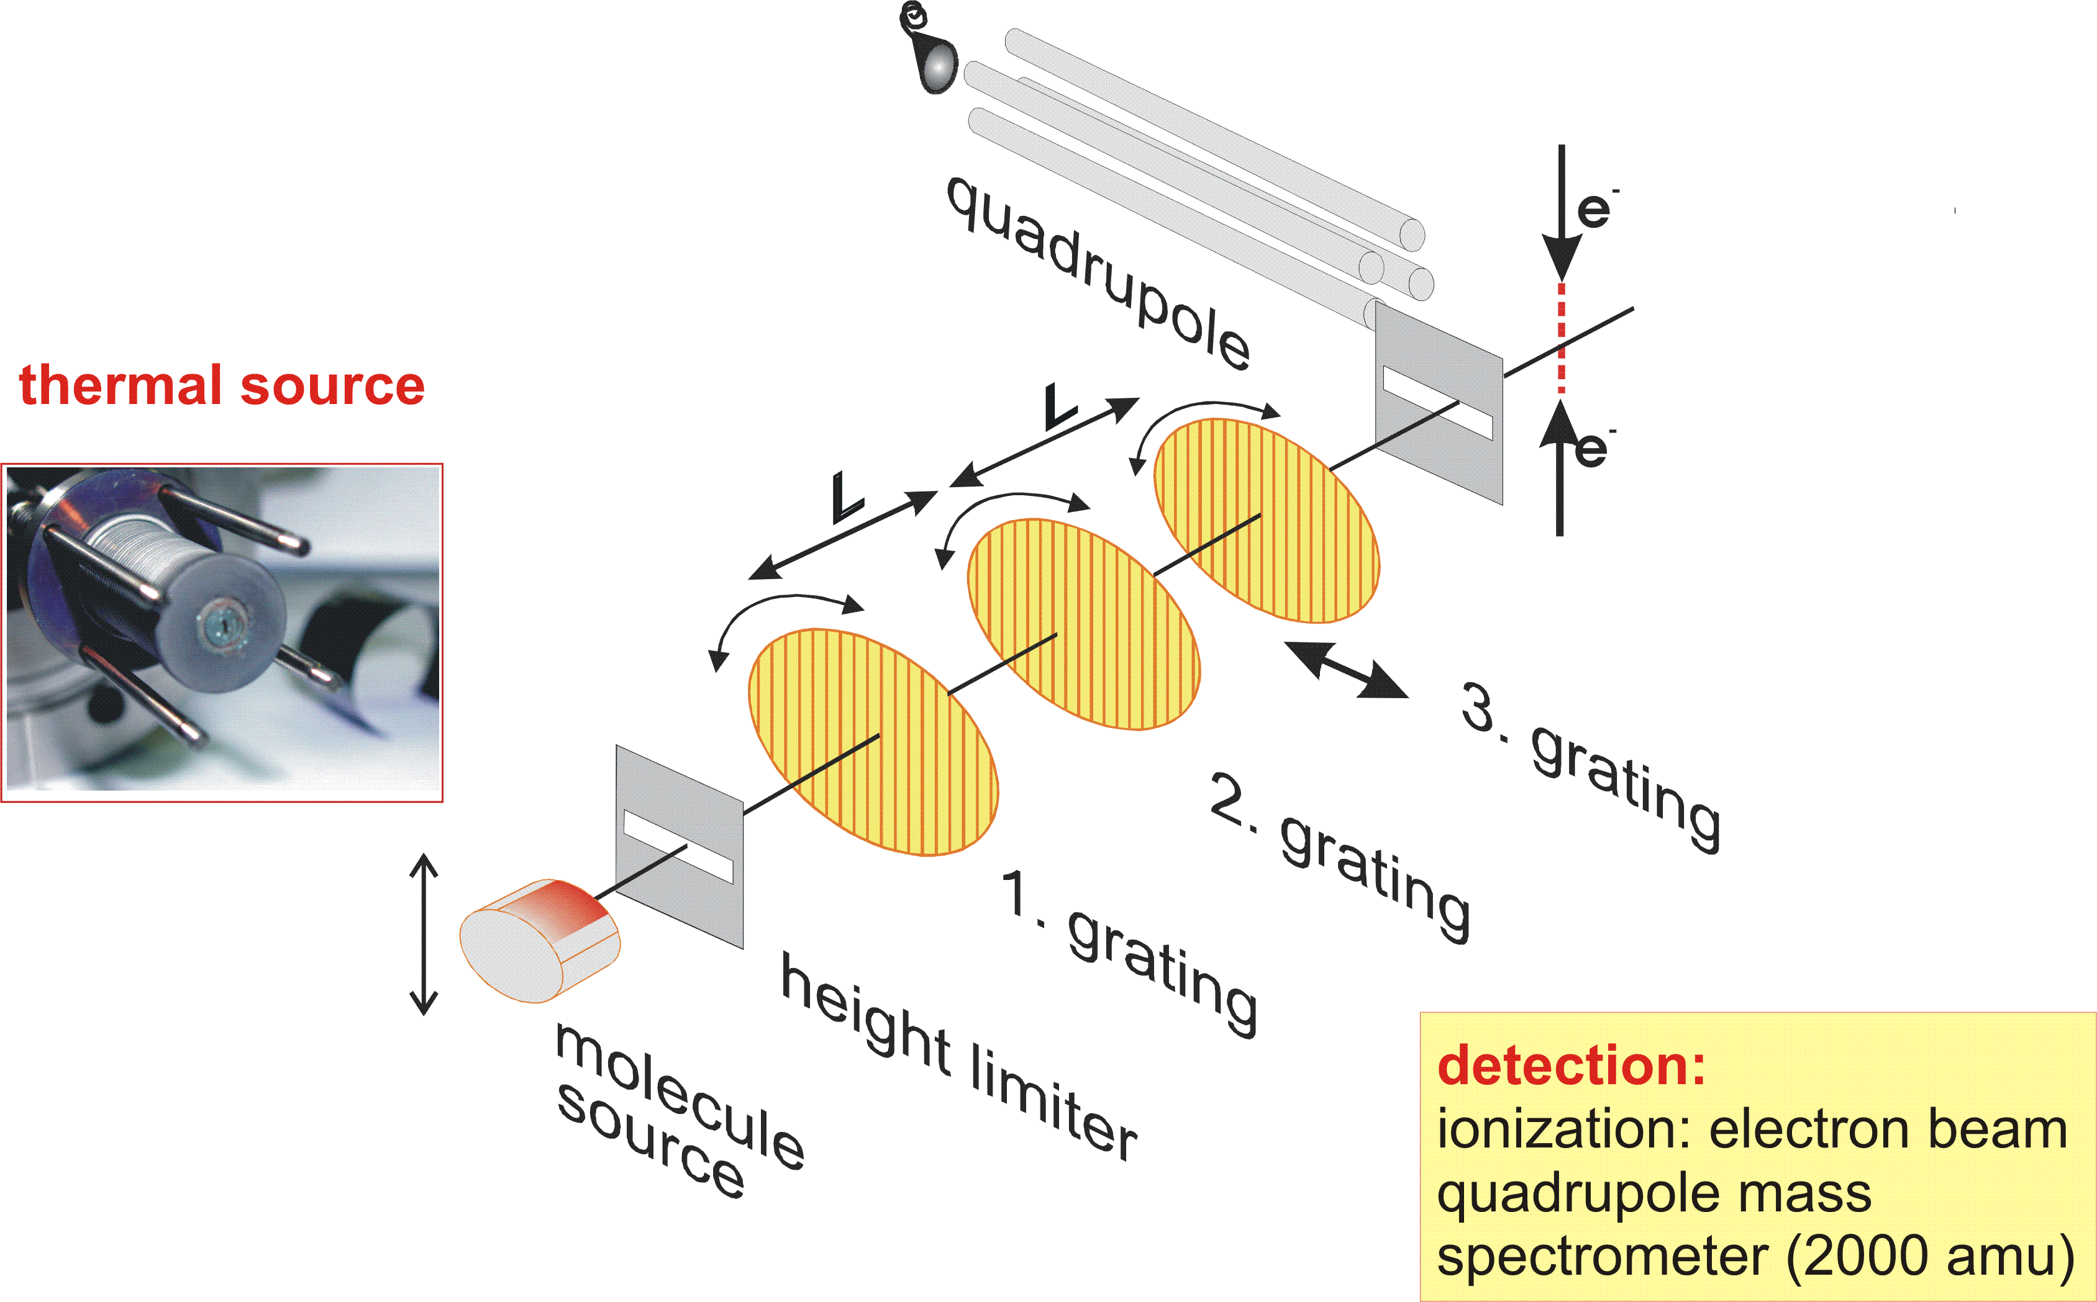
Wave + Particle = “Quantum”
Porphyrin rings fired at detector
through arrays of slits.

Slide 50
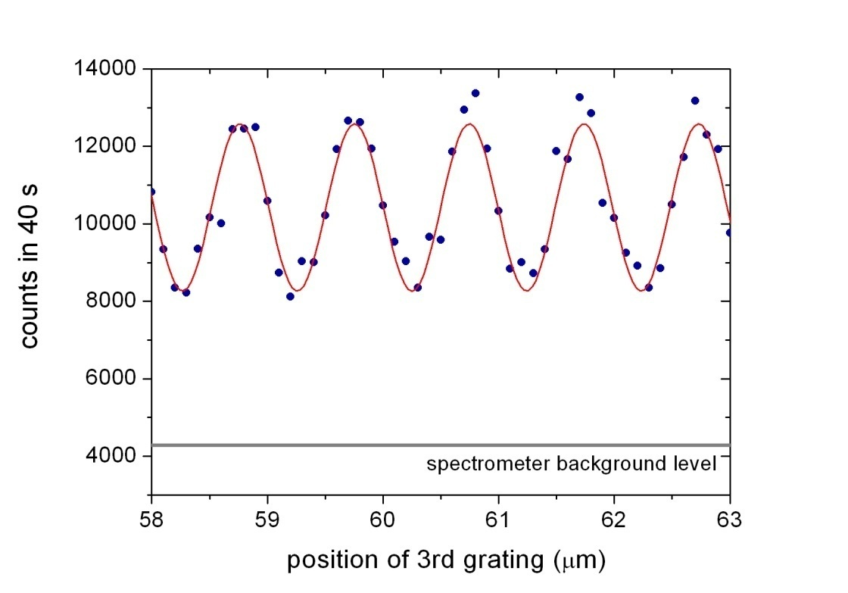
Wave + Particle = “Quantum”
Interference pattern appears as changes in the number of rings detected.

Slide 51
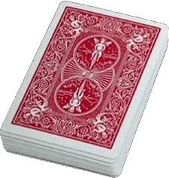
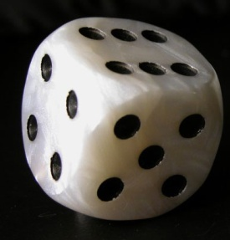
Quanta and Quantum Mechanics
For many experiments, Quantum Mechanics only predicts the probability of any outcome.
What kind of probability is this?

Slide 52
Two games
A deck of cards (no jokers) has been shuffled. Is the top card red (♦or ♥) or black (♣ or ♠) ?
A single die will be thrown. Will the outcome be odd or even?

Slide 53
Two games
A deck of cards has been shuffled…
A single die will be thrown…
Game #1: Outcome is predetermined but unknown.
Game #2: Outcome is undetermined (unknowable?).

Slide 54
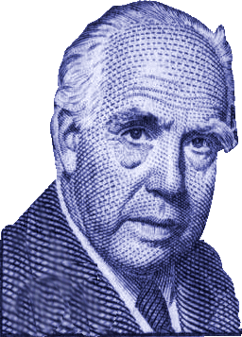
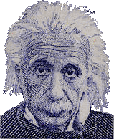
Interpretations of Q. Mechanics
Hidden Variables Interpretation:
Quantum Mechanics is not complete. There
is more information, but we don’t know it.
God does not play games with dice.
Copenhagen Interpretation:
Cards are not secretly shuffled in advance. There is no pre-determination.
Probability is all there is.
No dice.
Stop telling God what to do.

Slide 55
“Interpretations”
We use the word “interpretation” for ideas that are beyond the reach of experiments.
Is there a difference between a religion
and an interpretation?
There are other interpretations:
  Many Worlds (Hugh Everett)
  “Time waves” or Transactions (Emil Wolf)
Not always.

Slide 56

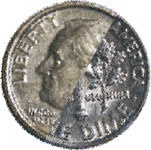
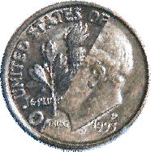
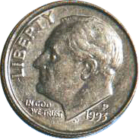
Mysteries of Copenhagen
Before observation, only “mixtures of probability” exist. Physical properties (to be measured) are undefined.
“Observer”
“Observation”, “measurement”, or “experiment” occurs.
After observation, measured physical properties are defined.

Slide 57

Mysteries of Copenhagen
How can a coin be a “superposition” of heads and tails?
How does it “snap” into one state or the other upon observation?

Slide 58
So maybe it’s all wrong?
1940:
Quantum Mechanics
+ Special Relativity
= Quantum Field Theory

Slide 59
Quantum Field Theory
Remember me?
Quantum Electrodynamics

Slide 60
Quantum Field Theory
Quantum Electrodynamics:
The magnetic moment of an electron is…
Theory:
1.00115965214 ± 0.00000000004
Experiment:
1.001159652181 ± 0.000000000001
Quantum Electrodynamics
The magnetic moment of an electron is…
Theory:
1.0011596521
Experiment:
1.0011596521

Slide 61

Quantum Field Theory
Theory: 1.00115965214 ± 0.00000000004
How accurate is that?

Slide 62

So maybe it’s all wrong?
Wave function “collapse” and reformation has been observed.

Slide 63

Through the looking glass:
Quantum Physics and Reality

Slide 64
Through the looking glass:
Four principles of “reality” that we believe in:
Peek-A-Boo
Fingerprints
Travel
Restaurants
(they might all be wrong)

Slide 65




Principle #1: Peek-A-Boo

Slide 66
Peek-A-Boo Logic
Object Permanence:
“Mommy comes back”
Things that disappear
from sight are still there.

Slide 67

The Peek-A-Boo Principle
Watch this experiment.

Slide 68

The Peek-A-Boo Principle
Watch this experiment.

Slide 69
The Peek-A-Boo Principle
Watch again.

Slide 70
The Peek-A-Boo Principle
Watch again.

Slide 71

The Peek-A-Boo Principle
What happened?
Was it this?

Slide 72

The Peek-A-Boo Principle
What happened?
Was it this?

Slide 73
The Peek-A-Boo Principle
Or was it this??

Slide 74

The Peek-A-Boo Principle
Or was it this??

Slide 75
The Peek-A-Boo Principle
Or was it this???

Slide 76

The Peek-A-Boo Principle
Or was it this???

Slide 77

The Peek-A-Boo Principle
The only way
for science
to answer the
question is to
repeat the
experiment…

Slide 78

The Peek-A-Boo Principle
The only way
for science
to answer the
question is to
repeat the
experiment…

Slide 79

The Peek-A-Boo Principle
…and repeat
it again…

Slide 80

The Peek-A-Boo Principle
…and again.

Slide 81
Peek-A-Boo Logic
Scientific inquiry does not allow us to assume the nature of phenomena that
are not observed.
Example…

Slide 82

Peek-A-Boo and Physics
Tunneling: Somehow quanta get from one place to another when it is impossible for them to be in between.

Slide 83

Peek-A-Boo and Physics
Tunneling: Somehow quanta get from one place to another when it is impossible for them to be in between.

Slide 84

Peek-A-Boo and Physics
We never see the particle inside the place where it is impossible to be (the barrier).

Slide 85

Peek-A-Boo and Physics
We never see the particle inside the place where it is impossible to be (the barrier).

Slide 86

Peek-A-Boo and Physics
We might want to get a snapshot like this…
… but nature doesn’t
care what we want.

Slide 87

Peek-A-Boo and Physics
Artist’s conception of tunneling:

Slide 88
Peek-A-Boo Logic
Scientific inquiry does not allow us to assume the nature of phenomena that
are not observed.
“Hidden variables” supposes these phenomena are there but does not suggest what they are.
“Copenhagen” and Peek-A-Boo
have a more complicated relationship.

Slide 89


Peek-A-Boo and Copenhagen
A radioactive atom “decays” when it emits radiation.
The leftover atom is physically changed.

Slide 90


Peek-A-Boo and Copenhagen
A superposition of “decayed” and
“un-decayed” states.
What if we put the atom in a box without an observer?
When it is in a box, I can’t tell whether it has decayed or not.
It hasn’t been observed, so “Copenhagen” says it exists in a superposition state.
Erwin Schrödinger (1935)

Slide 91



Peek-A-Boo and Copenhagen
Problem: If the cat hasn’t been observed, then isn’t the cat also in a superposition state of dead and alive?
How can a cat be
half dead?
Now add one cat.
Erwin Schrödinger (1935)

Slide 92

The Afshar Experiment
Peek-A-Boo
with
photons
Shahriar Afshar (2004)

Slide 93

The Afshar Experiment
Double slits with lens and mirrors:
Lens focuses light.
One detector is aligned with each slit.

Slide 94

The Afshar Experiment
Insert opaque wires where dark patches would be expected from a wave.
Photons show up at
detectors anyway.

Slide 95
The Afshar Conclusions
A photon can be a particle and a wave at the same time.
Wave interference happens after the photon path is identified, so the Copenhagen interpretation is wrong.
Both conclusions are flawed,
but they might be correct.

Slide 96
The Afshar’s Conclusions
A photon can be a particle and a wave at the same time.
But the photon is not
in these two places
at the same time.

Slide 97

The Afshar’s Conclusions
Wave interference happens after the photon path is identified, so the Copenhagen interpretation is wrong.
These are not the same statement!
Peek-A-Boo logic is at work.
Afshar observes:
If the photon travels
through pinhole #1,
then it winds up at
detector #1.
Afshar concludes:
If the photon arrived
at detector #1
then it came
through pinhole #1.

Slide 98

The Afshar Experiment
Key Question:
What does the Copenhagen interpretation predict will happen?
Surprising Answer:
This
Afshar illustrates new physics and the fallacy of Peek-A-Boo logic.

Slide 99
Lessons from Afshar
Peek-A-Boo Logic infects even expert minds.
Peek-A-Boo logic is unreliable.
But the Copenhagen interpretation just might be wrong.

Slide 100

Principle #2: Fingerprints
Fingerprints, Cupcakes, and Reality

Slide 101
The Cupcake Problem:
Alice and the Rabbit had six cupcakes all together.
They split the cupcakes evenly between them.
Create a representation to show how the cupcakes were split.

Slide 102








The Cupcake Problem:
Alice
Rabbit

Slide 103
Cupcake Logic:
Easy question #1:
Alice
Rabbit
Q: How many cupcakes did Alice get?
A: Three.

Slide 104
Cupcake Logic:
Easy question #2:
Alice
Rabbit
Q: Which three did Alice get?
A: The yellow, pink, and green ones.

Slide 105
Cupcake Logic:
More easy questions:
Q: What is six divided by two?
A: Three.
Q: Which three???

Slide 106
Cupcake Logic:
We call this “reality”…
but not this…
Why Not?

Slide 107
The Myth of Fingerprints:
Distinguishability
Objects are different and we can distinguish them.
I recognize my mom.

Slide 108





Fingerprints and Physics
All electrons are alike.
All protons are alike.
But completely indistinguishable.
Even THEY can’t tell them apart.
Not just similar as with identical twins.

Slide 109

Fingerprints and Physics
All electrons are alike.
All protons are alike.
Evidence!

Slide 110


The Mandel Experiment
Distinguished
photons
Leonard Mandel (1995)

Slide 111

The Mandel Experiment
Shoot identical photons (or electrons) through two slits. Will we get…
INTERFERENCE
OR
NO INTERFERENCE?

Slide 112

The Mandel Experiment
Now block Left slit. Photons only go through Right slit. Will we get…
INTERFERENCE
OR
NO INTERFERENCE?

Slide 113

The Mandel Experiment
Shoot distinguishable photons from two lasers. Will we get…
INTERFERENCE
OR
NO INTERFERENCE?

Slide 114

The Mandel Experiment
Shoot identical photons but put a detector over one slit. Will we get…
INTERFERENCE
OR
NO INTERFERENCE?

Slide 115
The Mandel Experiment
Same experiment, but turn the detector OFF (no human observer). Will we get…
INTERFERENCE
!!!
OR
NO INTERFERENCE?

Slide 116
The Mandel Experiment
Human observation is not necessary for quantum measurement effects!
The issue is not whether or not humans have information from a measurement.
The issue is whether or not the information exists!

Slide 117

Mandel and Schrödinger’s Cat
Schrodinger does not need
to observe the cat for it to be
definitely dead or definitely alive.
The presence of the cat is enough!
Thanks to Mandel,
the paradox of Schrodinger’s cat is …
Erwin Schrödinger (1935)

Slide 118
Mandel and Schrödinger’s Cat
Thanks to Mandel,
the paradox of Schrodinger’s cat is GONE!
Erwin Schrödinger (1935)

Slide 119

Mandel and Schrödinger’s Cat
You saw that coming,
Didn’t you?
The smile of Schrödinger’s cat:
What does it mean for
information to “exist”?
Thanks to Mandel,
the paradox of Schrodinger’s cat is GONE!
Erwin Schrödinger (1935)

Slide 120

The Mandel Experiment
Put detectors on BOTH slits. Will we get…
Good question!
INTERFERENCE
OR
NO INTERFERENCE?

Slide 121
The Mandel Experiment
Right Detector
Left Detector
Important details:
White boxes are crystals.
When original photons go through, the crystals send extra photons “sideways”
to waiting detectors.

Slide 122

The Mandel Experiment
Right Detector
Left Detector
As shown here...
INTERFERENCE
OR
NO INTERFERENCE?

Slide 123
The Mandel Experiment
“Both” Detector
Lonely Detector
But what if we mix the “sideways” photons together?
Does the behavior of the “forwards” photons change?

Slide 124

The Mandel Experiment
“Both” Detector
Lonely Detector
As shown here...
How does the fate
of these photons…
… influence these photons?
INTERFERENCE
OR
NO INTERFERENCE?
What is “information”?

Slide 125
Lessons from Mandel
Human observation does not create the universe.
Distinguishability rules quantum mechanics.
Meaning of the word “information” is important, but not obvious.

Slide 126



The Travel Principle:
Are we
there yet?
No.

Slide 127
The Travel Principle:
We can’t experience “there” unless
A) We go “there”, or
B) Something from “there” comes “here”.
The fastest anything can travel is
c = 700 million mph

Slide 128

The Travel Principle:
Nothing that happens on the moon can influence us for…
one second.

Slide 129


The Travel Principle:
No influence or information from the sun can reach us for…
eight minutes.

Slide 130
The Travel Principle:
Scientists call this idea “Locality.”
Without “locality” some
physicists fear for “causality.”

Slide 131

The Aspect Experiment
Photons
far flung
Alain Aspect (1982)

Slide 132


The Aspect Experiment
But first a word from Einstein…
Some radioactive atoms emit pairs of particles with opposite properties.
Einstein (1935)

Slide 133
The Aspect Experiment
Measure a property of this guy.
This guy will
have the opposite
property.
Einstein (1935)

Slide 134
The Aspect Experiment
Instant action at a distance isn’t
possible, so quantum mechanics
must not be “complete.”
“Copenhagen” says this guy’s properties are undefined until measurement happens here.
But that measurement would have an instant effect here.
There is more information
(aka “hidden variables”).
All physics is local.
Einstein (1935)

Slide 135


The Aspect Experiment
Einstein’s locality and
quantum mechanics are
distinct. An experiment
could distinguish them.
John Bell (1966)

Slide 136

The Aspect Experiment
Alain Aspect’s experiment, 1982.
Goal #1: Explore Bell’s Inequalities.
Goal #2: measure the LEFT photon before a signal from the RIGHT photon could reach it.

Slide 137

The Aspect Experiment
Aspect’s results
supported non-locality (99% confidence level)
Some said Aspect’s lab
wasn’t big enough.

Slide 138

The Aspect Experiment
7 miles!
CERN took care of that in 1998.

Slide 139


The Aspect Experiment
And the work has been repeated…
Harvard, 1998
Calgary, 2001

Slide 140
Lessons from Aspect
Did Bell’s Theorem and the
Aspect Experiments kill locality?
“No. Locality met it’s own demise.”
John Bell .

Slide 141

The Restaurant Principle
Welcome to the Quantum Café
How about
dessert?

Slide 142
Quantum Café
Dessert Menu
You may order:
Cake
Ice Cream
Something Chocolate
Something Vanilla
Your order will
be delivered instantaneously.
Just ask your waiter.

Slide 143




On other people’s tables
Looks pretty good, so…

Slide 144

I want something chocolate.

Slide 145
I want some
cake.

Slide 146
I want some
ice cream.

Slide 147
The Restaurant Principle
Maybe this guy only has two things.
He could have those two things hidden,
Maybe this guy only has two things.
He could have those two things hidden, and then he pulls
out whichever
one works.
Let’s check…

Slide 148
I want vanilla
ice cream.
Ah ha!

Slide 149
Watch this!
I want vanilla
ice cream.
Um…

Slide 150
I want vanilla
ice cream???

Slide 151
One more time…
I want vanilla
ice cream.
You’re messing with me, aren’t you?

Slide 152
The Restaurant Principle
I should get what I order.
What’s in the kitchen should determine what I can order.
Stuff in the kitchen shouldn’t change when I do order.
Scientists call this
“Determinism”

Slide 153


The Restaurant Principle
At the quantum café,
only half of our requests are granted.
The other half are completely random.
What would the ingredients look like?

Slide 154

The Restaurant Principle
Uncertainty
Some pairs of properties cannot be specified at the same time.
Mother Nature herself can’t control them in advance.
Werner Heisenberg (1927)

Slide 155

The Zeilinger Experiment
Uncertainty
vs.
Determinism
Anton Zeilinger (2000)

Slide 156



The Zeilinger Experiment
“Entangle” three photons “anti-symmetrically”
Force one value of “polarization”
Check the polarization of the other two
Deterministic Picture:
These two are forced to point down.
Force this one to “point up”

Slide 157



The Zeilinger Experiment
“Entangle” three photons “anti-symmetrically”
Force one value of “polarization”
Check the polarization of the other two
Anti-symmetric QM:
Force this one to “point up”
Observation “collapses” the superposition with one vector
“up” and one “down”
These two are forced into an anti-symmetric superposition state.

Slide 158


The Zeilinger Experiment
The results are “0 up”, “1 up”, “2 up”, or “3 up”
No fuzzy statistical uncertainties!
The predictions are…
Uncertain quantum physics:
One photon agrees with the 1st
Local determinism:
None of the others agree

Slide 159

The Zeilinger Experiment
Zeilinger’s results:
Quantum Mechanics wins out…
…every time
Uncertain quantum physics:
One photon agrees with the 1st
Local determinism:
None of the others agree
Other variations have all favored quantum uncertainty

Slide 160
Lessons from Zeilinger
Locality and Determinism
can’t both be correct.
It doesn’t look good for determinism.
But the flip side of determinism is…

Slide 161
Free Will
What is free will?
Presence of conscious intent
“I want to do something.”
Absence of predetermination
“My future includes choices.”
Free Will made simple:

Slide 162

Free Will
John Conway’s “Free Will Theorem”
If quantum states are uncertain, then humans and particles have free will.
But…
Conway’s argument depends on our ability to work at long distance at infinite speed.
He assumes non-locality.
If not, particle behavior
is predetermined,
and so is ours.
John Conway (2006)

Slide 163
The Reality Roster:
Object permanence (Peek-A-Boo)
    On the injured list
Distinguishability (Fingerprints)
    Dead
Locality (Travel)
    Critical condition
Determinism (Restaurants)
    Breathing on life support
(Note: Locality and Determinism
share one kidney between them.)

Slide 164

Science and Religion
“I do believe,” said Alice at last… “I’ll just call and say ‘How do you do?’ and
ask them the way
out of the wood.”
Artwork by John Tenniel

Slide 165

The Red King’s Dream
The Red King is sleeping.
Tweedledee: “You’re only a thing in his dream.”
Tweedledum: “If that there King was to wake, you'd go out -- bang! -- just like a candle!”

Slide 166
The Red King’s Dream
Alice wakes to find that she had been dreaming.
Lewis Carroll asks: “Which dreamed it?”
  Was Wonderland really created by Alice’s dream?
  Was Alice’s world created by the King’s dream?
  Or was none of it real at all?

Slide 167
Wonderland created by Alice:
We are all observers.
The universe snaps into existence as we observe it.
Everyone and everything is God.
(And we influence the outcomes.)
2004

Slide 168
Reality created by the Red King:
Quantum mechanics requires an observer.
There must have been an observer before there were humans.
Therefore God exists.
2003

Slide 169
Or none of it is real:
Wonderland and the Red King are imaginary.
Our physical universe is governed by chance.
Quantum physics is absurd.
Only a lunatic would create this universe.
2007

Slide 170
The Great Misinterpretation:
Many interpret the Copenhagen model of quantum mechanics to mean:
Quantum mechanics requires
conscious observation in order
for reality to take definite shape.
Mandel, Aspect, and Zeilinger have all shown this is not necessarily true.

Slide 171
Room for Interpretation:
The Great Misinterpretation:
The misinterpretation is that:
Quantum mechanics requires
conscious observation in order
for reality to take definite shape.
The correct reading should be...
allows

Slide 172
Science and Religion
All 3 are possible interpretations of modern physics.
All 3 lie outside of the realm of science.

Slide 173

Why worry about the confusion?
What’s wrong with
injecting religion
into science?
“I think you should be more explicit here in step two.”

Slide 174

The fine line
Where does
injecting religion into science end
and rejecting science begin?
If our religion doesn’t fit in the rabbit hole…
Do we simply kill
the rabbit?
Artwork by Julie Inman

Slide 175

The fine line
How do we combine
science and religion?
Do we have to
make a choice?
Artwork by Ken Wong

Slide 176

“The net of science covers the empirical realm…The net of religion extends over questions of moral meaning and value. These two magisteria do not overlap, nor do they encompass all inquiry.”
Stephen Jay Gould

Slide 177

“Religion, Art, and Science are branches of the same tree.”
“If something is in me which can be called religious then it is an unbounded admiration for the structure of the world so far as our science can reveal it.”
“Imagination is more
important than knowledge,
for … imagination embraces … all there ever will be to know.”
Albert Einstein

Slide 178



“What we need is imagination, but imagination in a terrible strait-jacket. We have to find a view of the world but that view has to agree with nature.”
Richard Feynman
“There are more things in heaven and earth, Horatio, than are dreamt of in your philosophy.”
Hamlet, Act I, Scene V
Artwork by Julian Voss-Andrae

Slide 179


“Nothing is too wonderful to be consistent with the laws of nature.”
Michael Faraday
Experiment by Jennifer Sebby-Strabley
Artwork by Julian Voss-Andrae

Slide 180

The End
“Still she haunts me, phantomwise,
Alice moving under skies…
Lingering in the golden gleam,
Life, what is it but a dream?”
Lewis Carroll

