Slide 1
A famous face in fluid dynamics
Do you know this face?

Slide 2
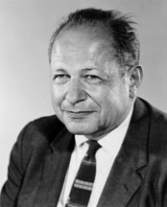
Do you know this face?

Slide 3
Do you know this face?
Check out the eyes

Slide 4
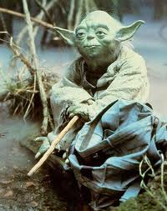
Do you know this face?
Anything yet?
Check out the eyes

Slide 5
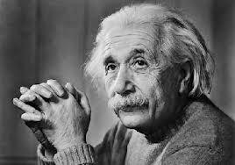
Do you know this face?
Anything yet?
Check out the eyes
Got it yet?

Slide 6
Do you know this face?
Hans Albert Einstein
1904 - 1973

