Slide 1
Flow rate depends on:
Potential difference
“resistance” (or “conductance”)
Permeability (or “roughness”)

Slide 2
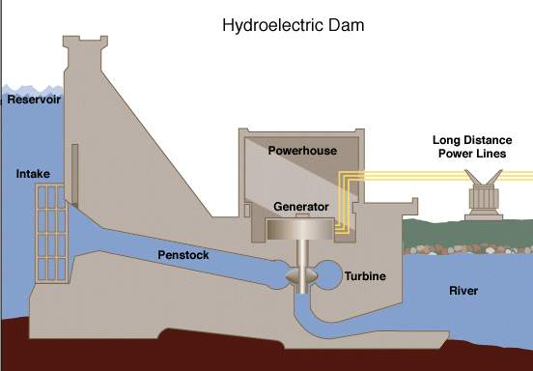
Water flows from high potential to low potential
High potential
Same high potential
Lower potential
A high flow rate generates lots of power

Slide 3
In a water pipe: “resistance” is determined by…
Area:
Inversely proportional in pipes with obstacles
Is the pipe full of sand? gravel? large rocks?
Inversely prop. to area² in hollow pipes
Inversely prop. to permeability of obstacles if any (sand, gravel…)
Length (directly proportion)
Viscosity (directly proportion)
The opposite of Conductance is
“RESISTANCE” = 1/conductance

Slide 4
In an electric wire or light bulb: “conductance” is proportional to (area x conductivity)/length
Area (size of “wire” or “filament”)
Conductivity (the current must flow around atoms in the wire)
The opposite of Conductance is
“RESISTANCE”

Slide 5
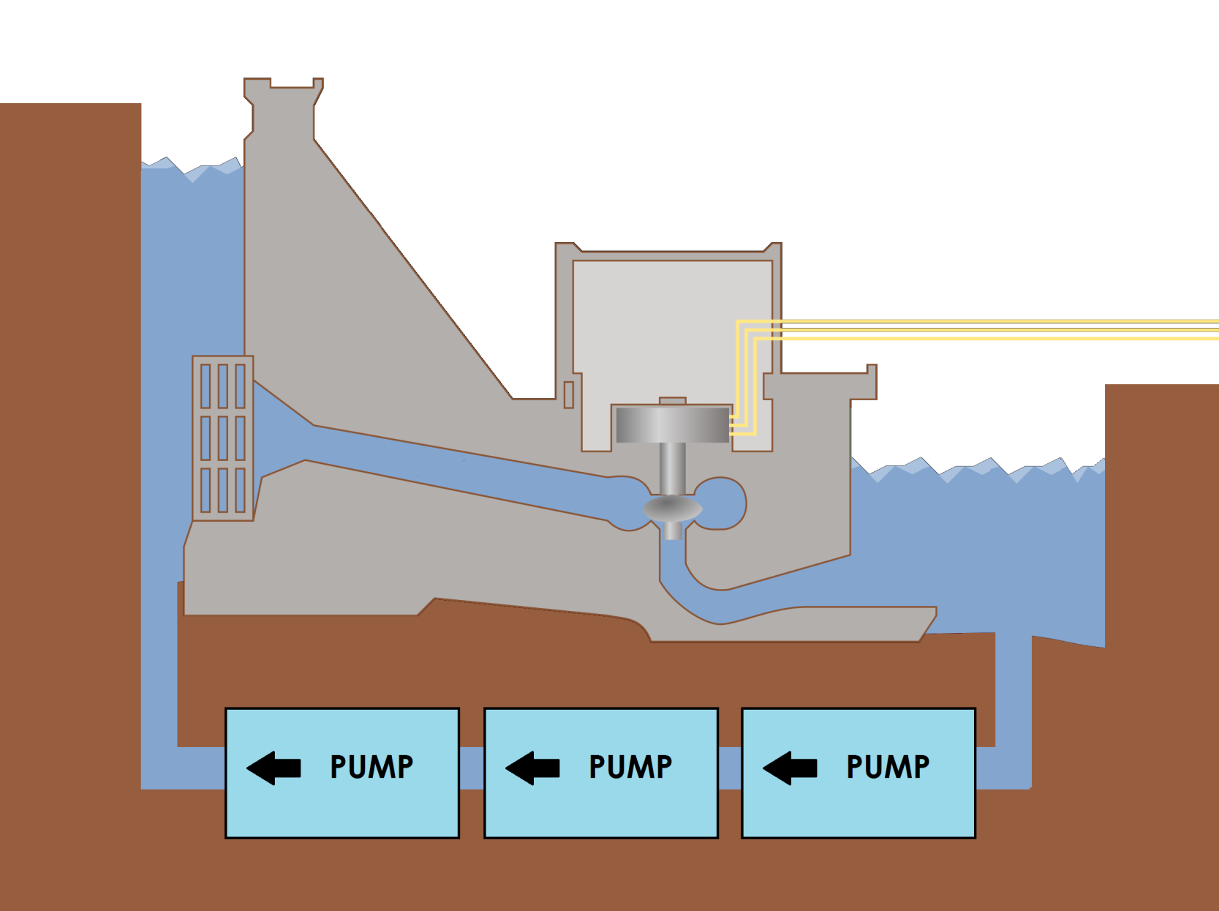
Imagine water flowing in a “loop” or “circuit”

Slide 6
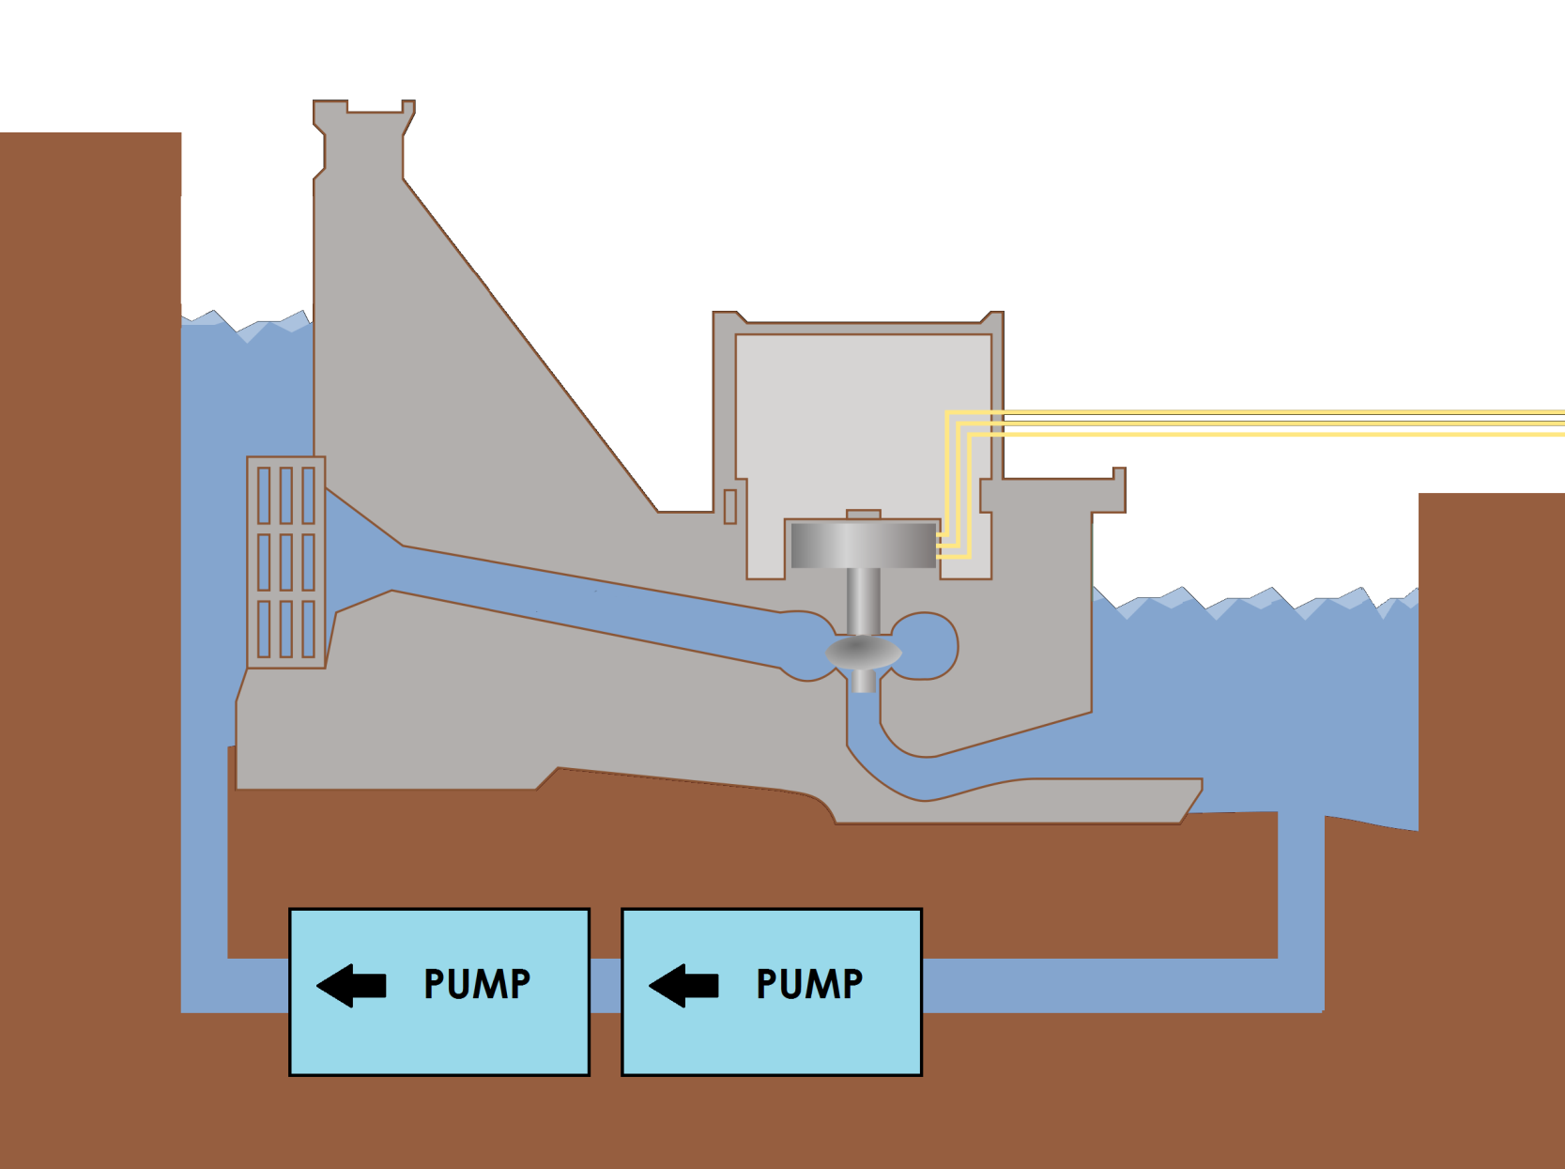
Imagine water flowing in a “loop” or “circuit”

Slide 7
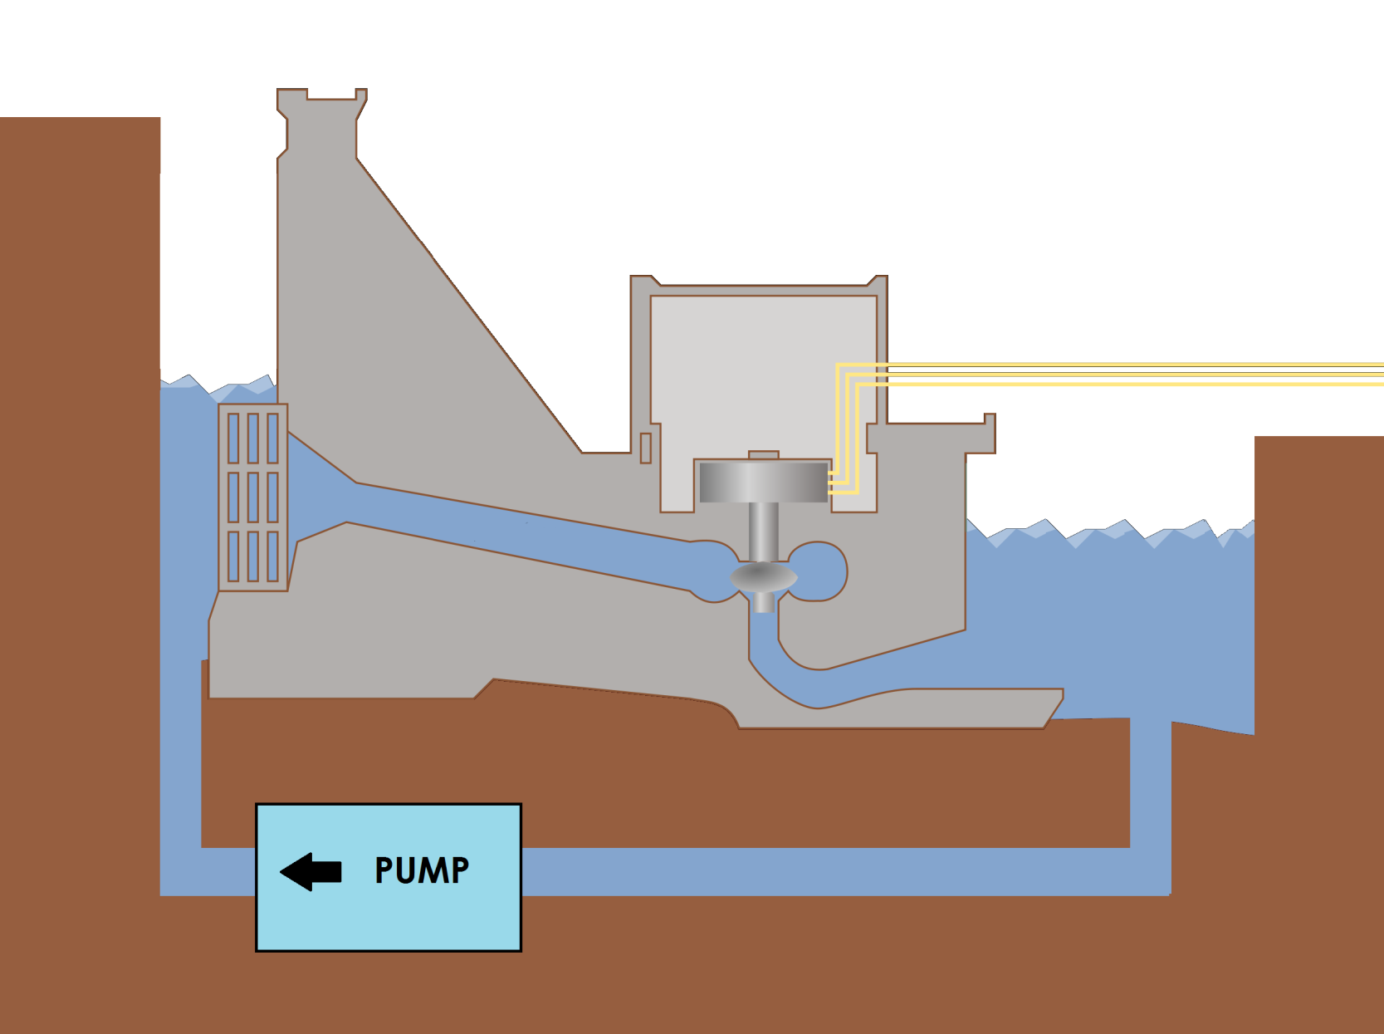
Imagine water flowing in a “loop” or “circuit”

Slide 8
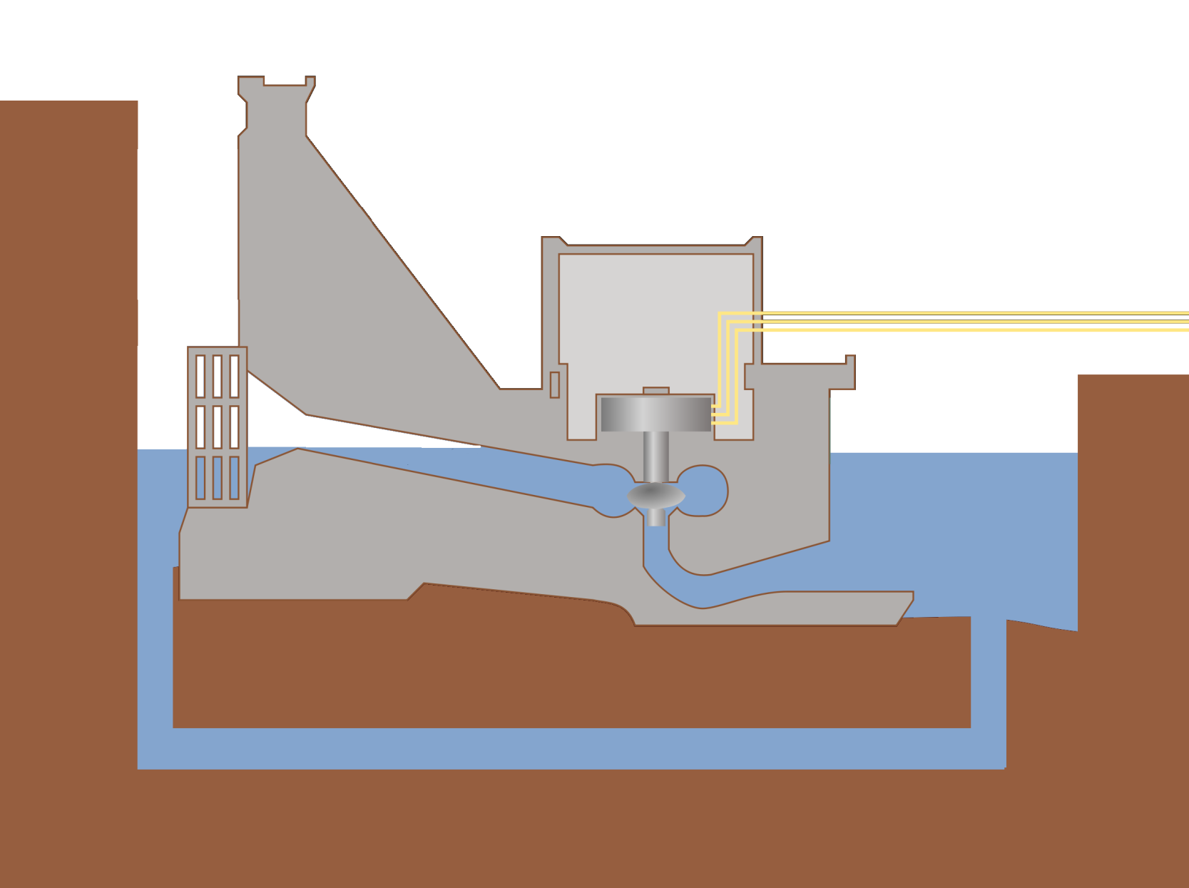
Imagine water flowing in a “loop” or “circuit”

