Slide 1
Phasor diagrams
Assume all diagrams represent RLC Circuits (driven damped harmonic oscillators).
All phasor diagrams rotate counter-clockwise. You may choose either axis to represent voltage.

Slide 2
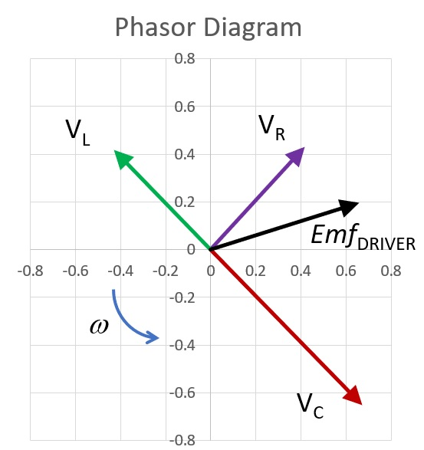
Diagram 1
Describe this diagram.
Is it possible?
If so, is the circuit “capacitative” or “inductive”?
If possible, what would you do to ω to bring the circuit into resonance?

Slide 3
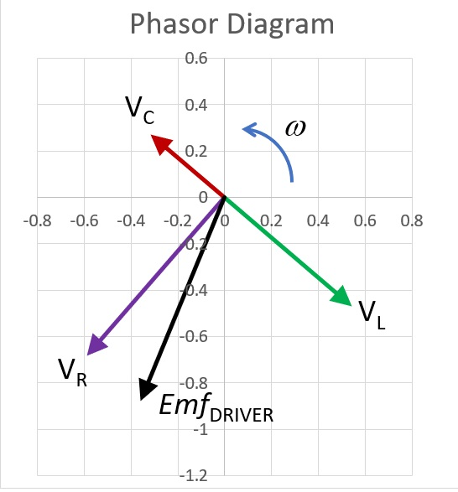
Diagram 2
Describe this diagram.
Is it possible?
If so, is the circuit “capacitative” or “inductive”?
If possible, what would you do to ω to bring the circuit into resonance?

Slide 4
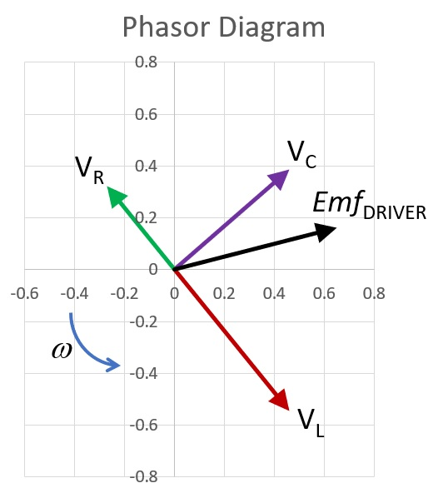
Diagram 3
Describe this diagram.
Is it possible?
If so, is the circuit “capacitative” or “inductive”?
If possible, what would you do to ω to bring the circuit into resonance?

Slide 5
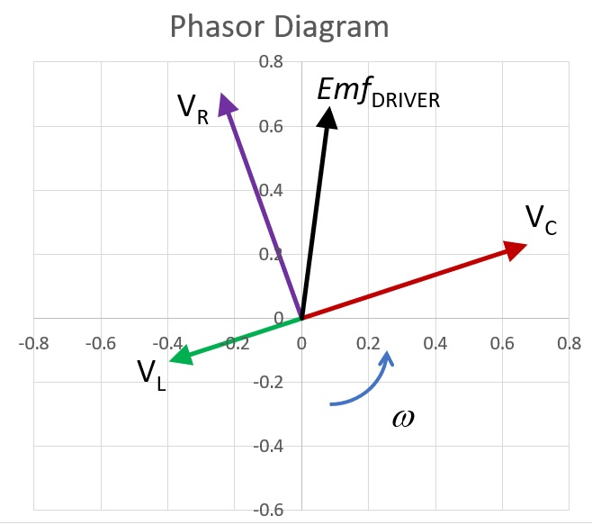
Diagram 4
Describe this diagram.
Is it possible?
If so, is the circuit “capacitative” or “inductive”?
If possible, what would you do to ω to bring the circuit into resonance?

