Slide 1
Math Module Courses Orientation
Math 68, 78, 88, 98
Mathematics Division
Independent Study Mathematics Opportunities
Please pick up a red folder and make sure you get a course code handout, a yellow module log, and a blank contract.

Slide 2
Math 68, 78, 88, 98
Contacting Me
Mathematics Division
Name: Rochelle Mitchell
E-mail: rmitchell@greenriver.edu
Office: CH 301-13
Office Hour: Monday through Thursday 1:00 – 1:50 PM
Phone: Use ALEKS or email instead of phones
Make sure you get a copy of my card; there is a spot for it in the red folder. (The card may already be in there! ☺)

Slide 3
Math 68, 78, 88, 98
Why a Math Module?
Mathematics Division
You are taking a “regular” lecture or FLEX math course and want to improve your grade. (FLEX courses use Hawkes Learning Systems)
You want to get ready for the course into which you were placed by the Compass test.
You want to study on your own, with hopes of improving your Compass placement without taking a 5-credit class.

Slide 4
Math 68, 78, 88, 98
In all cases:
Mathematics Division
For 2 credits, you are committing to doing 40 hours of work using the ALEKS software. (20 hours = 1 credit)
Time is kept by the program so you don’t need a time sheet.
You must write two 1-page papers, one at the midterm, and one at the end of the quarter. (more on this later!)

Slide 5
Math 68, 78, 88, 98
Midterm Deadline
Mathematics Division
May 6 – 9, 2017– mark that on your contract on the line: I will complete approximately half of my hours on ALEKS by the middle of the quarter and turn the red folder (with the midterm paper) into the MLC (CH-313) or my instructor during the middle week of the quarter. The middle of the quarter is: _ May 6 – 9, 2017___ (FILL IN DATES HERE!). (These dates are on the Power Point Slides.)
You should have about 20 hours on ALEKS at the midterm deadline.
Put the first 1-page paper in the front of your red folder. This should include a description of the resources the Math Division provides and which one(s) you took advantage of. More on this later.
Drop the folder off in the MLC. Make sure your yellow log sheet is included. Pick the folder back up in the MLC in 1-2 days.

Slide 6
Math 68, 78, 88, 98
Final Deadline
Mathematics Division
June 13, 2017– mark that on your contract on the line: I will return the red module folder with final and midterm papers to my instructor or the Math Learning Center (CH-313) on or before:
June 13, 2017______(FILL IN DATE HERE)
Put BOTH 1-page papers in the front of your folder. The final paper should be a description of what math you worked on and an evaluation of the course . More on this later.
Drop the folder off in the MLC (CH 313). Leave the initialed yellow log sheet with the folder.

Slide 7
Math 68, 78, 88, 98
Did you say papers in a math class?
Mathematics Division
Yes, here is what is required:
Midterm paper:
1 whole page typed - regular margins, 12 point font, double spaced; this should be at least 350 words. (I will only count words if it looks short).
Description of all (actually just a lot of) the extra resources provided by the Math Division and which one(s) you took advantage of. You must use at least one of them. Check your folder for some websites that might help you find some of the resources. (ALEKS is not a resource; it is a required part of the course.)

Slide 8
Math 68, 78, 88, 98
Recap of the papers
Mathematics Division
More on the Midterm paper.
You should approach the midterm in this way: Pretend you are writing an article for the school paper. Make your first sentences be something like the following. “Are you taking a math class? You should know about the extra resources that the Math Division has for math students.”
Remember that you do not need to use all the resources; as you write your article, mention which one or ones you have used though. ALEKS is not a resource for this.
Make sure you keep an electronic copy of the paper!!

Slide 9
Math 68, 78, 88, 98
Recap of the papers
Mathematics Division
Final paper:
1 whole page typed (same deal: at least 350 words).
A summary of what math you worked on. If there were applications of the math that you found useful or interesting, tell us about them.
An evaluation of the course. Did it meet your needs? Did you do better in a regular math course (if you were taking one)? Did you pass the entrance exam (if you were attempting one)? Was ALEKS right for you?
Make sure you keep an electronic copy of the paper!

Slide 10
ALEKS Registration
Mathematics Division
Before You Begin you will need:
A 10-Digit Course Code provided by your instructor (see next slide)
A 20-Digit Student Access Code purchased at the bookstore or purchased online
Some of the remaining slides will be duplicated in your red folder. If you open your red folder there is space to make notes. The print in the red folder is small, so it helps to have the folder open for notes while you watch the rest of the slides or video. The course codes will be on a separate handout. In the orientation I will go through these slides quickly; refer back to your notes in your folder when you buy the software.

Slide 11
Prior to Registration
Mathematics Division
Before You Begin you will need:
A 10-Digit Course Code provided by your instructor
Get your 10 digit course code from us. This is different for each course and each quarter. It will be on a separate handout AND HERE:
Math 62R/Basic Math TUWW6-KA4XF Math 70R/Prealgebra RGDMP-ARKPA Math 72R/Beginning Algebra QCEUY-K6JQU Math 97R/Intermediate Algebra QEXTX-LHPUV

Slide 12
Prior to Registration
Mathematics Division
Before You Begin you will need:
A 20-Digit Student Access Code purchased at the bookstore or purchased online.
Go to http://www.aleks.com/sign_up/mhhe and walk through the steps to purchase an Access Code. Be sure you order the “Higher-Ed 1- Quarter (11 weeks)” version for $60. (see pictures on the next few slides). The other option, if you prefer, is to buy the code at the bookstore for about $77. If someone is reimbursing you for the cost of the software or you don’t have a credit card, the bookstore option may be more attractive. Otherwise, many prefer to save the extra money. The Access Code you are buying is a 20 digit code.

Slide 13
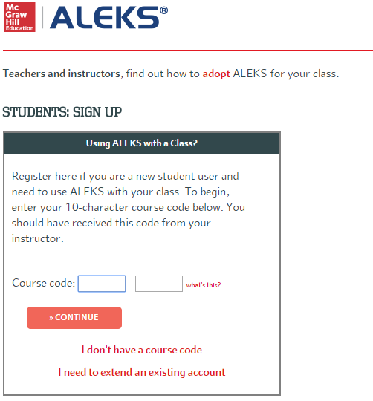
The link on the previous page gets you to here.

Slide 14
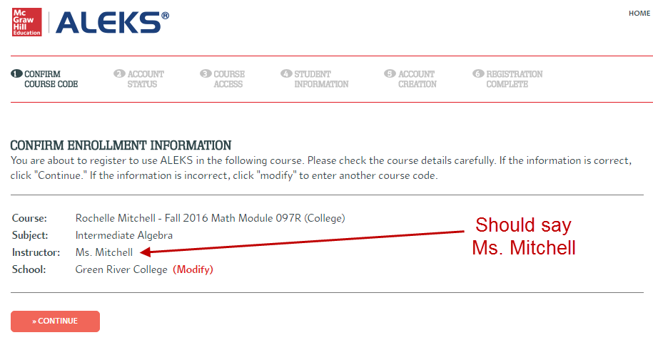
After you put in the course code, you should see this confirmation. Make sure the course is the correct one. Hit continue.
Should say Ms. Mitchell ☺

Slide 15
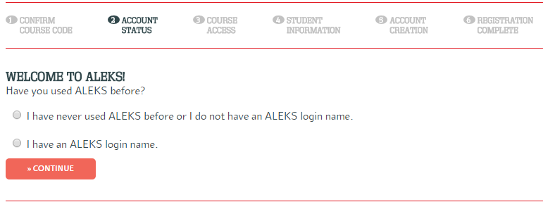
First time users pick the first option. If you already have a login, choose the second option.

Slide 16
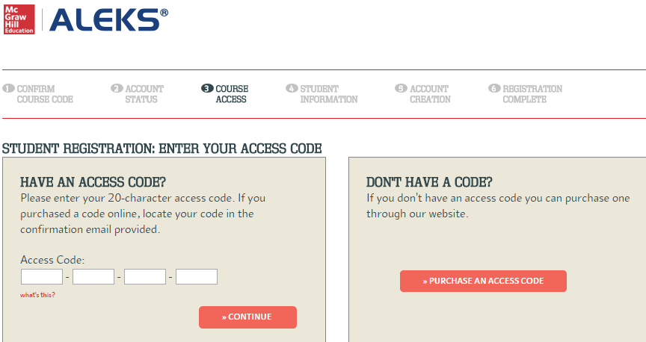
On this page, you will find a link to buy the access code. If you already bought the access code at the bookstore, you enter the code in the boxes.

Slide 17
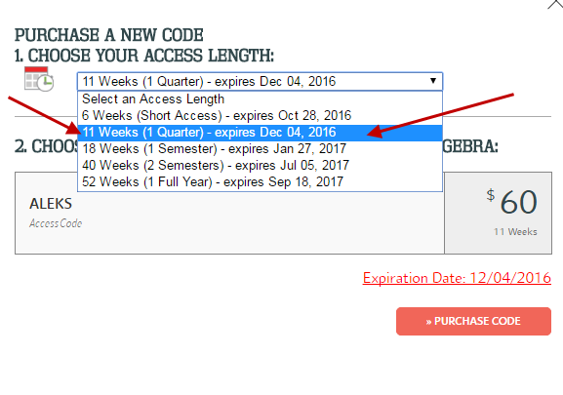
You will see a pop up menu when purchasing your access code online. Be sure to choose the 11 Week option. (Short Access will NOT work.)

Slide 18
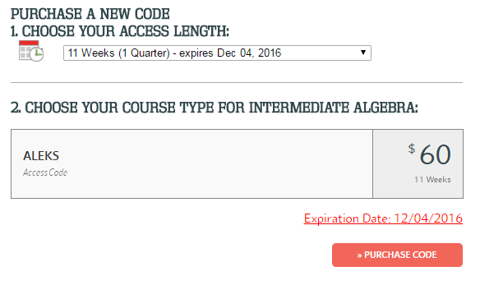
Now, all you need to do is “Purchase Code” ☺

Slide 19
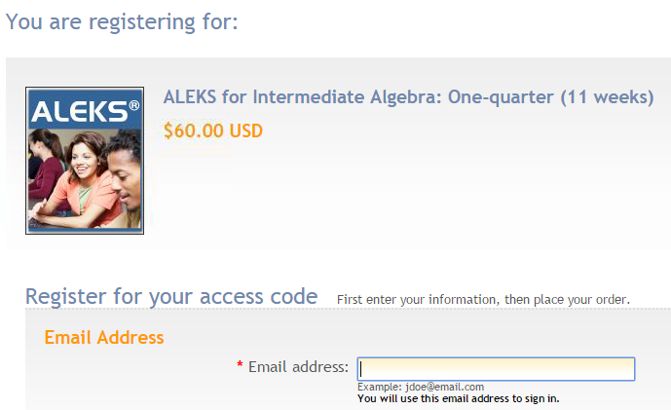
The next few web pages after this one ask for a lot of information. They are not duplicated here.

Slide 20
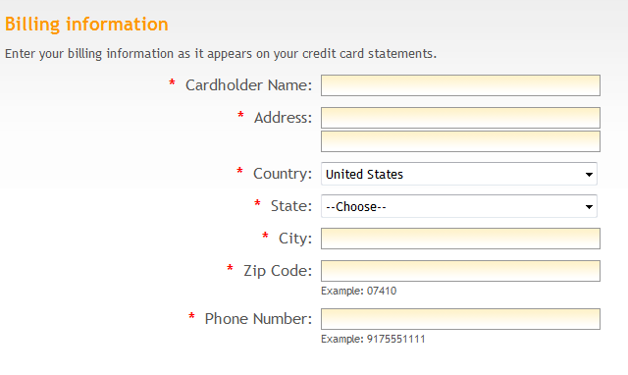
You must have a credit card for this option

Slide 21
After completing your registration and payment information, select “continue” at the bottom of the page. Review and place your order to complete your registration. IMPORTANT: If you are waiting on a financial aid check, let us know if you need a temporary code which gives you time before you have to pay.

Slide 22
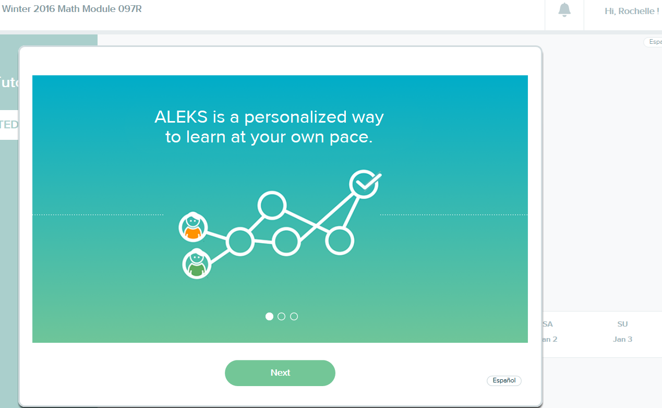
Math 68, 78, 88, 98
Using ALEKS
Mathematics Division
When you log onto ALEKS (at www.aleks.com),you will start a tour of the program.

Slide 23
Math 68, 78, 88, 98
Using ALEKS
Mathematics Division
After a few clicks, you will complete a ALEKS Tools Tutorial.

Slide 24
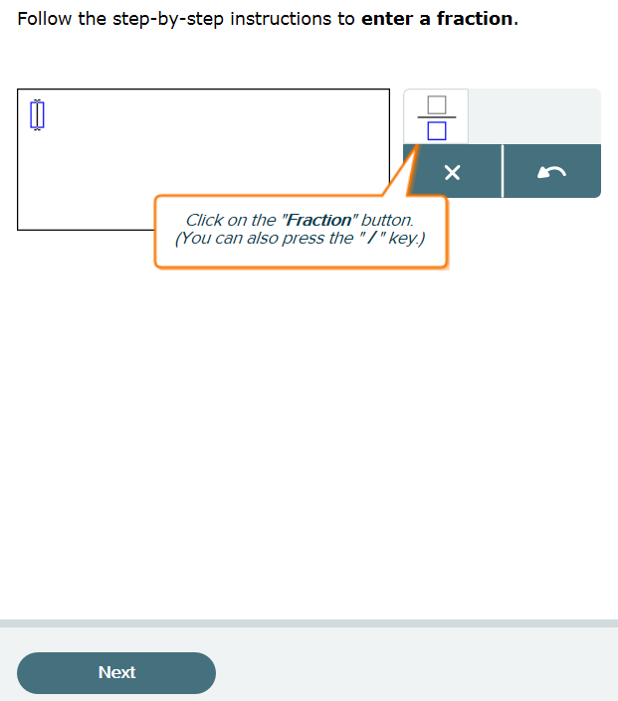
Math 68, 78, 88, 98
Using ALEKS
Mathematics Division
You will learn some important information like how to enter answers into ALEKS. ☺

Slide 25
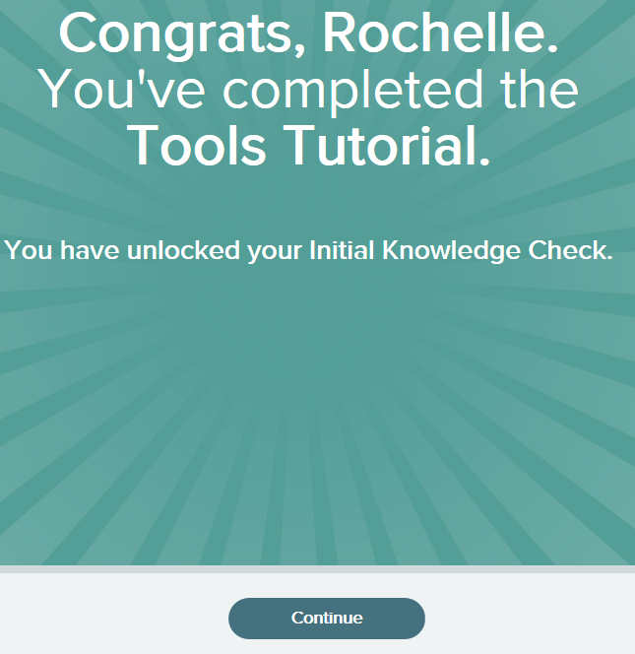
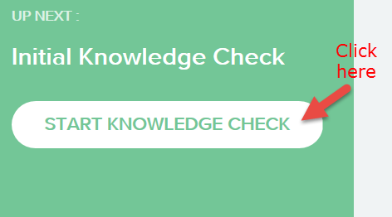
Math 68, 78, 88, 98
Using ALEKS
Mathematics Division
Next, you will take your Initial Knowledge Check.

Slide 26
Math 68, 78, 88, 98
Initial Knowledge Check
Mathematics Division
Before you do anything, you have to do an assessment, or knowledge check. You want to do this “honestly” meaning you don’t skip problems you can possibly do, and you don’t get help to do problems you really don’t know how to do. Both of those hurt your learning process, and remember that you are only graded on your time, not how well you do or how much of your pie is filled in. (See pie on later slide)

Slide 27
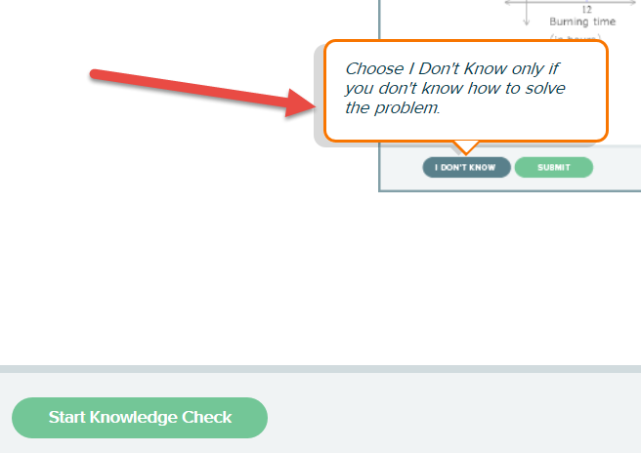
Math 68, 78, 88, 98
Initial Knowledge Check
Mathematics Division
Remember, the best thing you can do if you don’t know how to do a problem is say so. ☺

Slide 28
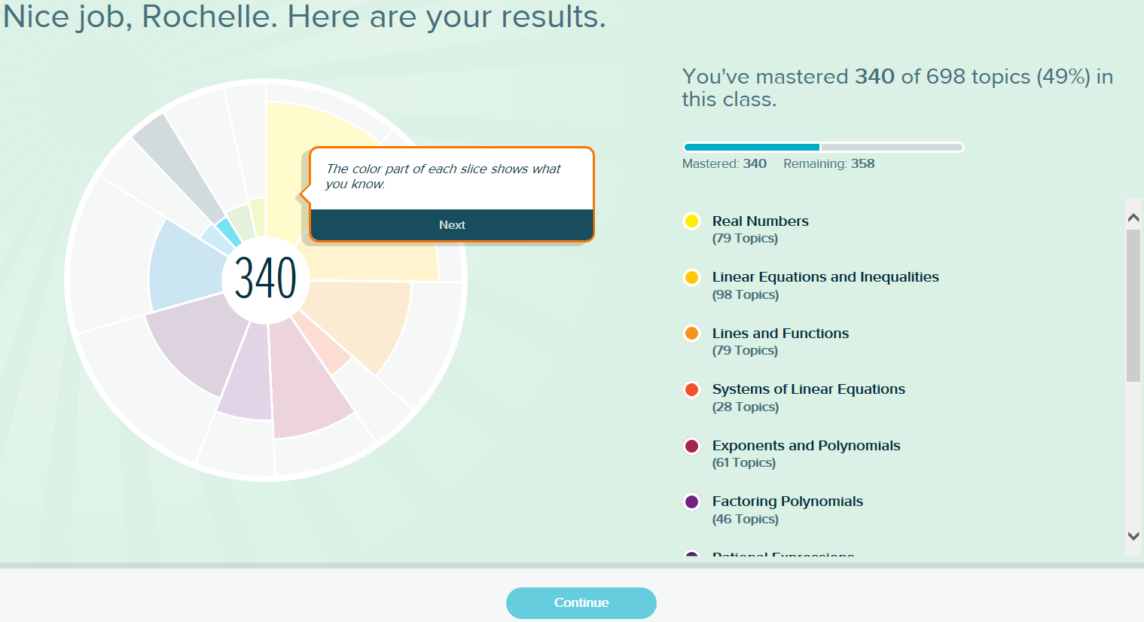
Math 68, 78, 88, 98
When you complete your knowledge check, you will see your “PIE”.
Mathematics Division

Slide 29
Math 68, 78, 88, 98
The Pie highlights topics you have mastered in color. The outer edges of the PIE in light grey are topics you need to work on. You can click on pieces of the PIE to see specific area topics.
Mathematics Division

Slide 30
Math 68, 78, 88, 98
PIE Topics
Mathematics Division
The topics for the course are listed to the right. Aleks will direct you to cover them in this order, but I will show you how to skip around in case you so desire.

Slide 31
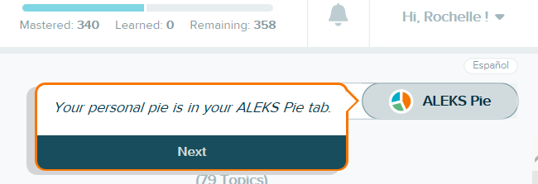
Math 68, 78, 88, 98
ALEKS PIE
Mathematics Division
You can access your ALEKS PIE with the tab shown below.

Slide 32
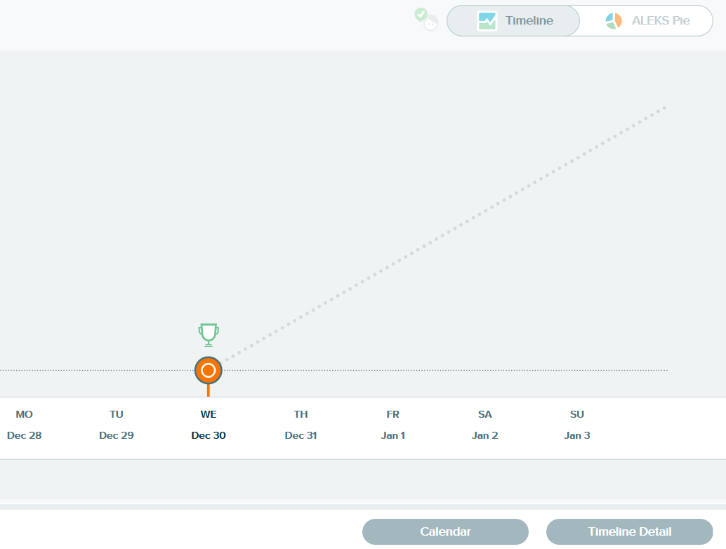
Math 68, 78, 88, 98
Your Timeline (not useful for this class)
Mathematics Division
The Timeline talks about “your goal”. However, your goal in this class is NOT to complete ALL of the topics. Rather, you goal is to complete 40 hours (for 2 credits). While you do this, you will complete as many topics as you can.

Slide 33
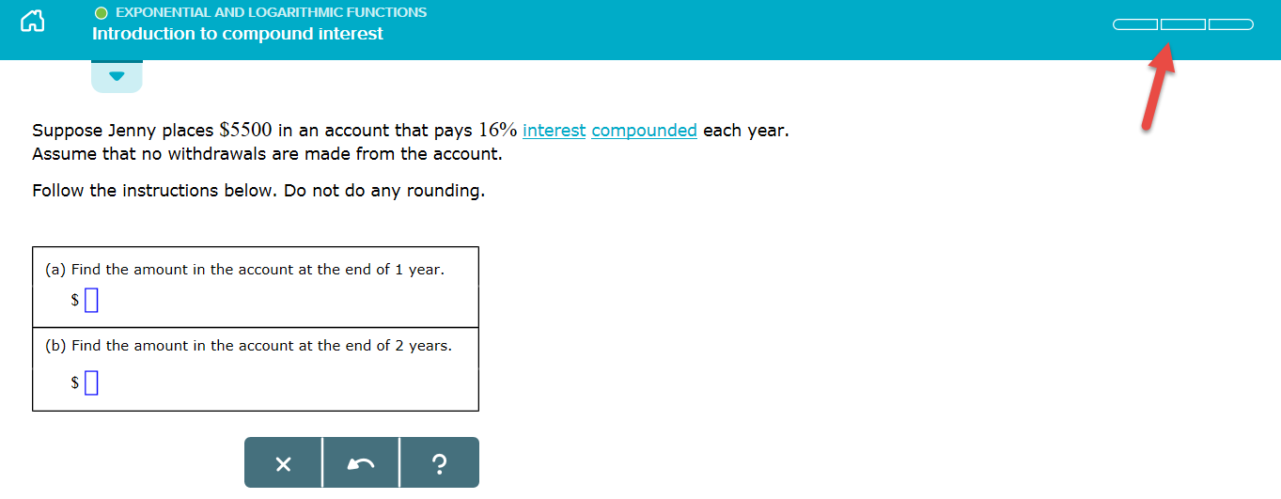
Math 68, 78, 88, 98
Working in ALEKS
Mathematics Division
At the top right, you will see how many questions you need to get correct to “finish” a topic.

Slide 34
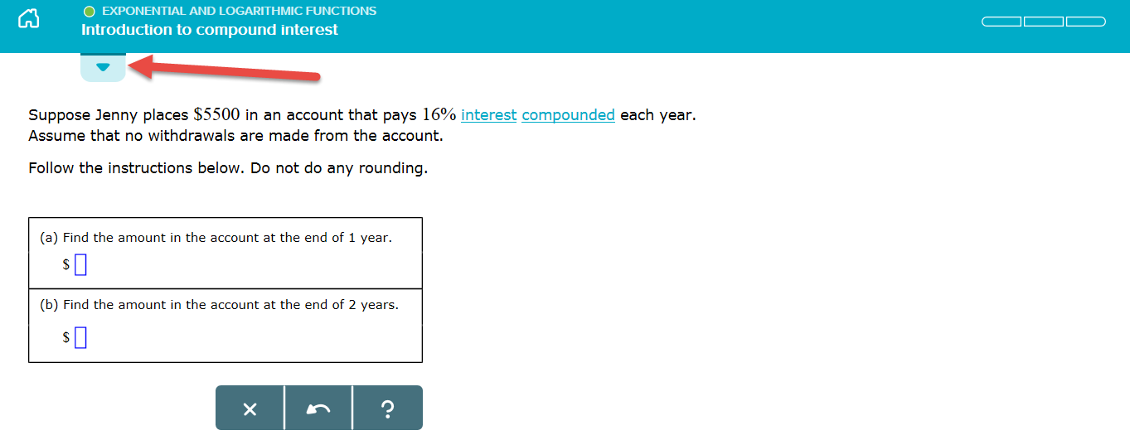
Math 68, 78, 88, 98
Working in ALEKS
Mathematics Division
Aleks will start you with a topic it chooses. However, you can change topics if you want. Select the down arrow tab on the left.

Slide 35
Math 68, 78, 88, 98
Working in ALEKS
Mathematics Division
To select a different topic,
Click on the “Ready to Learn” drop down menu to see a list of the topics.
OR
Scroll to the right using the arrow at the right.
Then, select the topic you wish to work on.

Slide 36
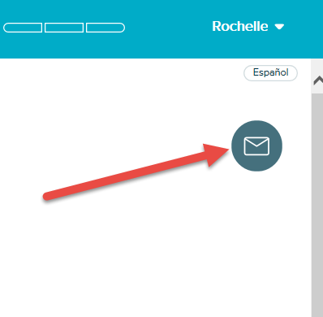
Math 68, 78, 88, 98
Sending me a Message
Mathematics Division
At any time, you can send me a message using the envelope icon on the right side of the screen.

Slide 37
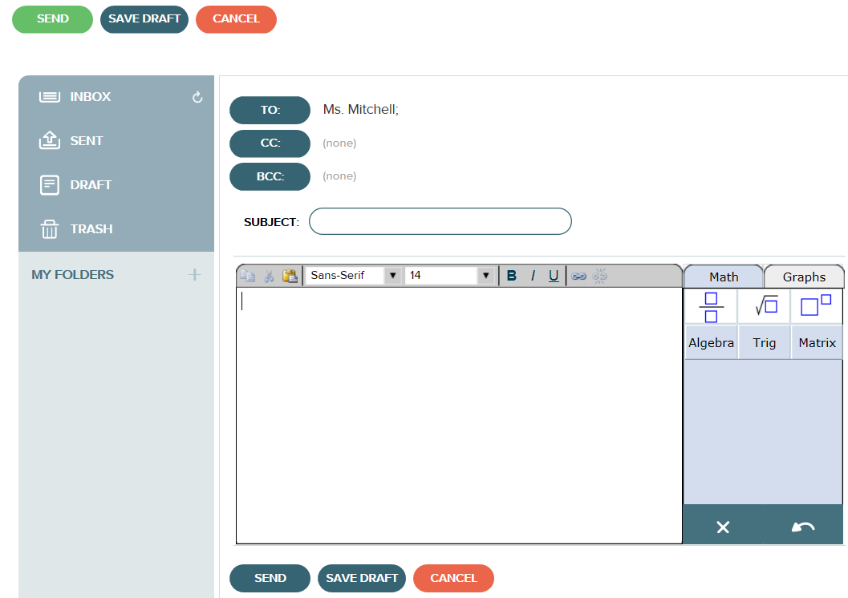
Math 68, 78, 88, 98
Sending me a Message
Mathematics Division
You can enter in math related questions, too.
Don’t forget to enter a subject and hit Send! ☺

Slide 38
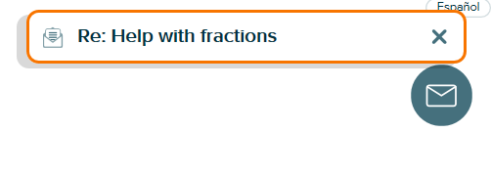
Math 68, 78, 88, 98
Checking Messages
Mathematics Division
Don’t forget to check messages I send to you!
I will send email reminders and announcements through ALEKS. ☺

Slide 39
Math 68, 78, 88, 98
Checking your Time
Mathematics Division
If you are working on your topics, select the Home icon.

Slide 40
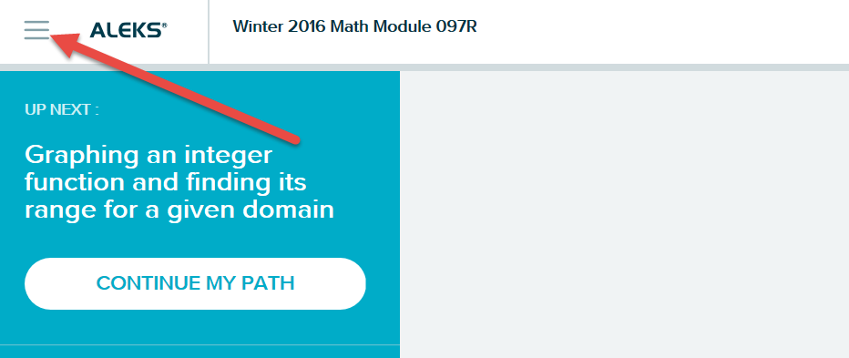
Math 68, 78, 88, 98
Checking your Time
Mathematics Division
From the home screen, select the icon with the 3 lines.

Slide 41
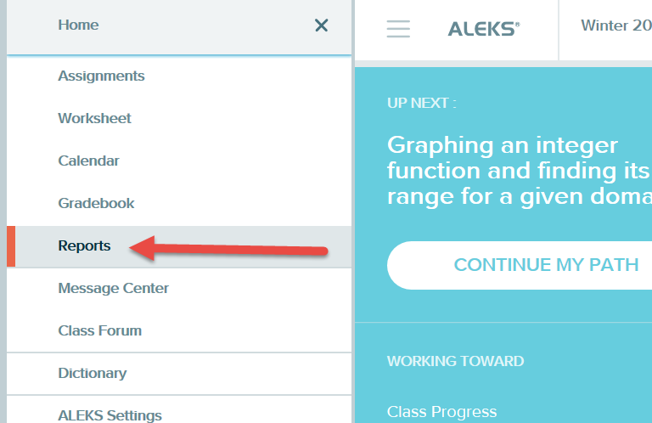
Math 68, 78, 88, 98
Checking your Time
Mathematics Division
Then, select Reports.

Slide 42
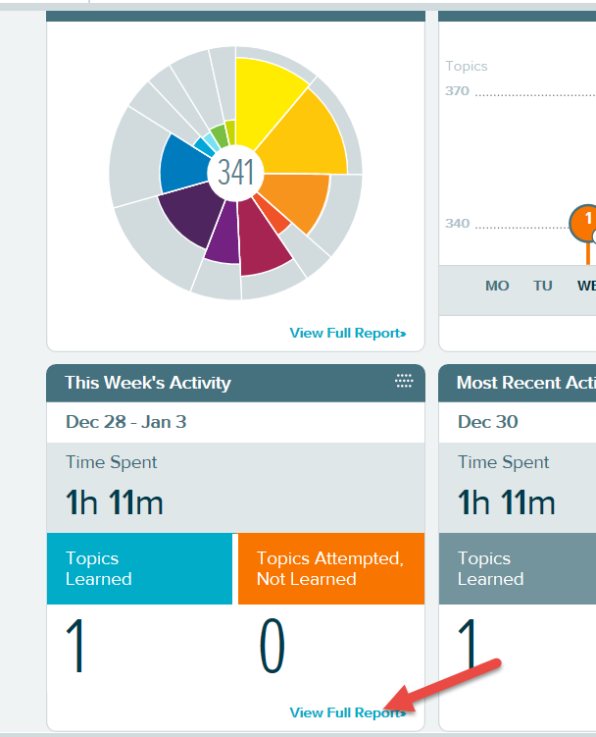
Math 68, 78, 88, 98
Checking your Time
Mathematics Division
Under the report entitled “This Week’s Activity”, select “View Full Report.”

Slide 43
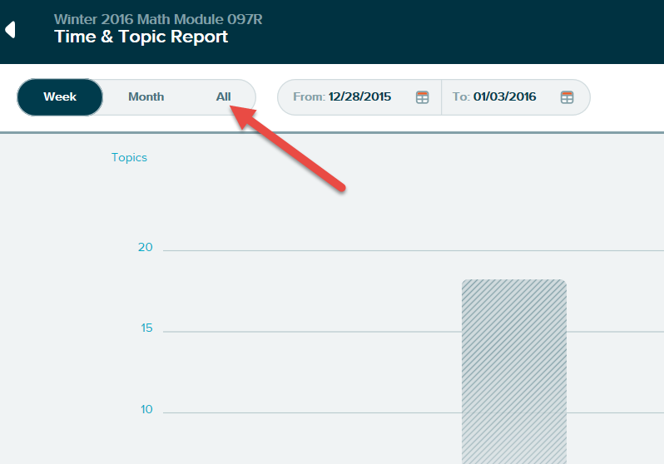
Math 68, 78, 88, 98
Checking your Time
Mathematics Division
Select “All” at top to see your total hours.

Slide 44
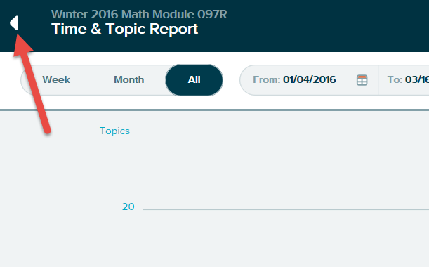
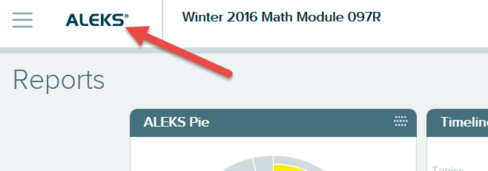
Math 68, 78, 88, 98
Returning to Home Screen
Mathematics Division
Click on the arrow at the top left.
Then, click on ALEKS.

Slide 45
Math 68, 78, 88, 98
What to do if you have problems with ALEKS:
Mathematics Division
Go to: support.aleks.com
Phone them at 714-619-7090
If they are not responsive, let us know, but they are usually really good.

Slide 46
Math 68, 78, 88, 98
Where do I start?
Mathematics Division
Make sure you have the directions on how to purchase ALEKS (in the folder) and the course code (separate page)
Make sure you have directions on how to sign up for your Green River email (in the folder)
Get logged on to ALEKS as soon as you can.

Slide 47
Math 68, 78, 88, 98
Where do I start? (Part 2)
Mathematics Division
Read over the ALEKS user guide. It is available as a webpage ( http://www.aleks.com/user_guides/learners-highedmath ) or a PDF that can be printed out (http://www.aleks.com/manual/pdf/learners-highedmath.pdf ). Mark the date for this on your time log.
Start doing a little bit of math very often…Try not to do 4 hours at a sitting.

Slide 48
Math 68, 78, 88, 98
What’s left today?
Mathematics Division
Fill out your contract. Initial all the statements. Fill in the appropriate midterm and final dates. Sign and date the contract. Write your name on the label on the cover of your folder
If you have Financial Aid or DSS paperwork, give it to your instructor.
If this is orientation and there is time, we will go on. If there is not time, you will come back to the webpage and watch the rest of the video or read through the rest of the power point slides.

Slide 49
Math 68, 78, 88, 98
FAQ
(Frequently Asked Questions)
Mathematics Division
Does this class meet the Prerequisite for the next course?
NO! However, you can take an Entrance Exam at the end of the class, and if you get 80% or above you will get permission to move on to the next class. This is only reasonable if you are reviewing material you have previously learned.
Do we meet again as a group?
No. You do check in with us at mid quarter, but there is not another group meeting.

Slide 50
Math 68, 78, 88, 98
FAQ
(Frequently Asked Questions)
Mathematics Division
Do I have to do my work at the MLC?
No. You may do your work on ALEKS anywhere that you have internet access. However, the most successful students are those that schedule it into their day. That is often easier if you go to the MLC.
What if I don’t finish 40 hours?
If you do at least 20 hours, and do BOTH 1-page papers, we will give you 1 credit. Be aware that you may then fall below the 12 credits needed for financial aid, athletics, car insurance, etc.
Is this a regularly graded class?
No. It is only Pass/No credit grading.

Slide 51
Math 68, 78, 88, 98
FAQ
(Frequently Asked Questions)
Mathematics Division
How do I access my Green River email address?
Go to http://grcc.greenriver.edu/student-email/. Make sure you have the handout that describes the email system. It is in your folder. If you still want to use your current email address, have the GRCC one forwarded to your old one, or check them both.
Will this email address go away?
No it is yours for life!
Do I have to buy ALEKS?
Yes it is a course requirement for your 40 hours.

Slide 52
Math 68, 78, 88, 98
FAQ
(Frequently Asked Questions)
Mathematics Division
What about ALEKS worksheets? (READ THIS!)
These are a little problematic. The time doesn’t show on ALEKS. Also the answers are not provided unless you ask your instructor for them each time. Do not use the worksheets unless you are doing them on your own time and not counting them for this class. Clicking on them immediately sends your instrictor a solution sheet, so we know when you have done it.
Why do they ask me to sign in at the MLC?
That is unrelated to the module classes. Their funding is dependent on usage, so you are helping us to keep the MLC financially afloat. Please sign in there.

Slide 53
Math 68, 78, 88, 98
FAQ
(Frequently Asked Questions)
Mathematics Division
If I am in Math 78, do I need to cover Math 70 material?
No. You work on those topics the you need help with, no matter what course those topics are from. That is the strength of ALEKS. If you decide the material is too easy or too hard, let me know.
Can I count other reading/study/tutoring time towards my hours?
No. Nothing (except workshops) counts towards your 40 hours except what you do on ALEKS. ALEKS keeps track of the time and progress. WORKSHEETS DO NOT COUNT!

Slide 54
Math 68, 78, 88, 98
MLC Resources Available
Mathematics Division
The MLC (Math Learning Center) is in CH 313 (Pay attention; your first paper needs this kind of info!!)
Videos
Some text specific
Calculator videos for Math 78, 98
You will learn better if you watch with pencil and paper in hand
Tutors
Available ___ am-___ pm Mondays through Thursdays
And ____am - ___ pm on Fridays
Always work with pencil and paper and don’t let the tutors just work the problems for you. Make sure you understand!

Slide 55
Math 68, 78, 88, 98
Mathematics Division
MLC Resources Available
Extra Textbooks
Pick Annotated Instructors Editions (AIE), if available.
If not an AIE, work odd problems with answers.
Computer Software
Make sure you use pencil and paper to work the problems
Workshops
Calculator and other workshops are sometimes offered. These count instead of ALEKS. They are the only things that reduce your 40 hour ALEKS requirement.

